Slide 1

50.039 Theory and Practice of Deep Learning W10-S3 Generative Models in Deep Learning
Matthieu De Mari

Slide 2
About this week (Week 10)
What are typical generative models in deep learning?
What is an autoencoder and what are its uses?
What is a fractionally strided convolution layer?
What are variational autoencoders and why do noise representations of latent features work better than the ones in standard autoencoders?
What are Generative Adversarial Networks (GANs) and their uses?
What are the advanced techniques in GANs and deepfakes?

Slide 3
About this week (Week 10)
What are typical generative models in deep learning?
What is an autoencoder and what are its uses?
What is a fractionally strided convolution layer?
What are variational autoencoders and why do noise representations of latent features work better than the ones in standard autoencoders?
What are Generative Adversarial Networks (GANs) and their uses?
What are the advanced techniques in GANs and deepfakes?

Slide 4
Outline
In this lecture
More advanced concepts on GANs
Wasserstein distance in the GAN loss function
Progressive GANs
StyleGANs
Conditional GANs and CycleGANs
Deepfakes and ethics

Slide 5

Outline
In this lecture
More advanced concepts on GANs
Wasserstein distance in the GAN loss function
Conditional GANs
Progressive GANs
StyleGANs
CycleGANs
Deepfakes and ethics

Slide 6
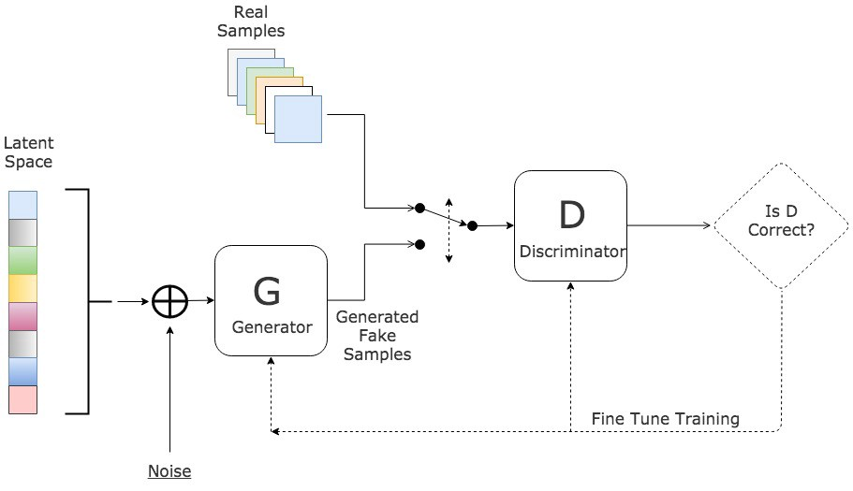
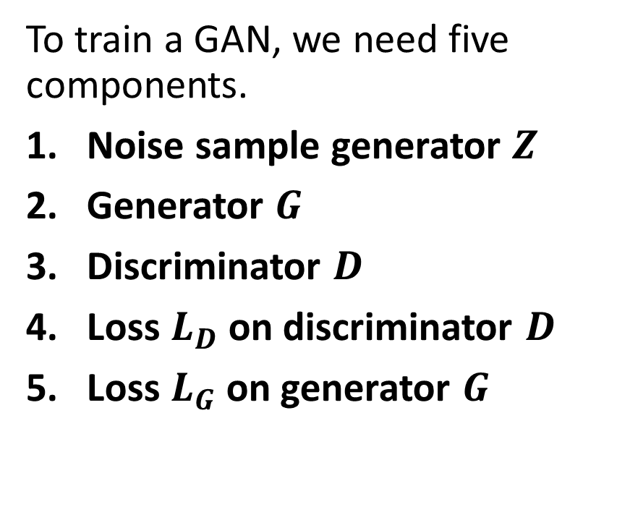
Vanilla GAN architecture
To train a GAN, we need five components.
Noise sample generator $Z$
Generator $G$
Discriminator $D$
Loss $L_{D}$on discriminator $D$
Loss $L_{G}$on generator $G$

Slide 7
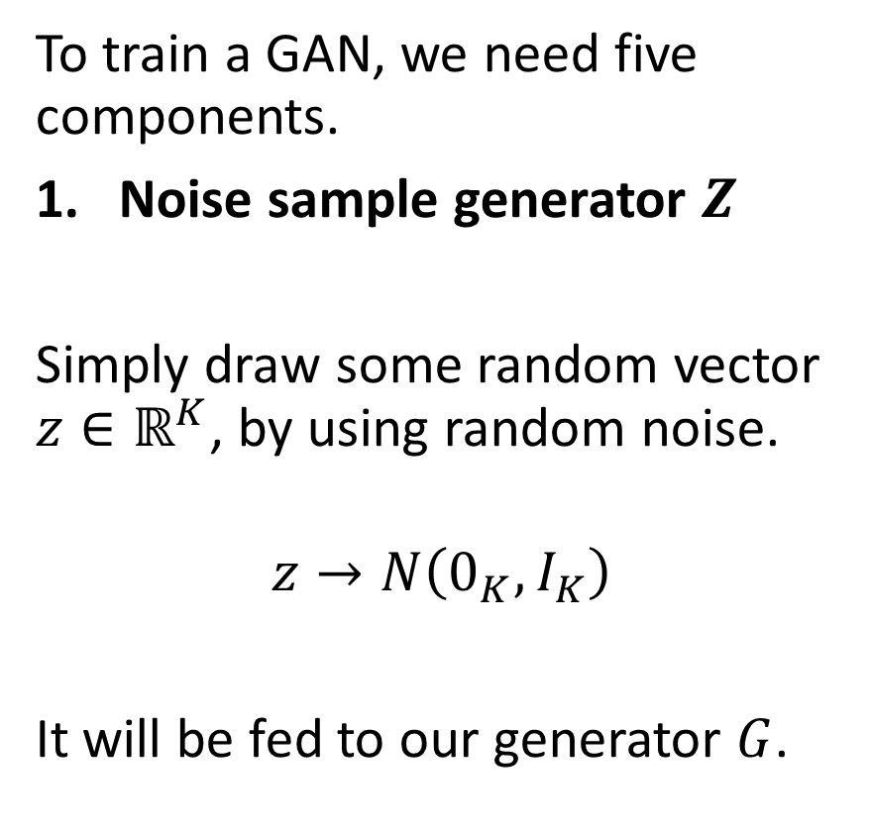
Vanilla GAN architecture
To train a GAN, we need five components.
Noise sample generator $Z$
Simply draw some random vector $z∈ℝ^{K}$, by using random noise.
$$z→N\left(0_{K},I_{K}\right)$$
It will be fed to our generator $G$.

Slide 8
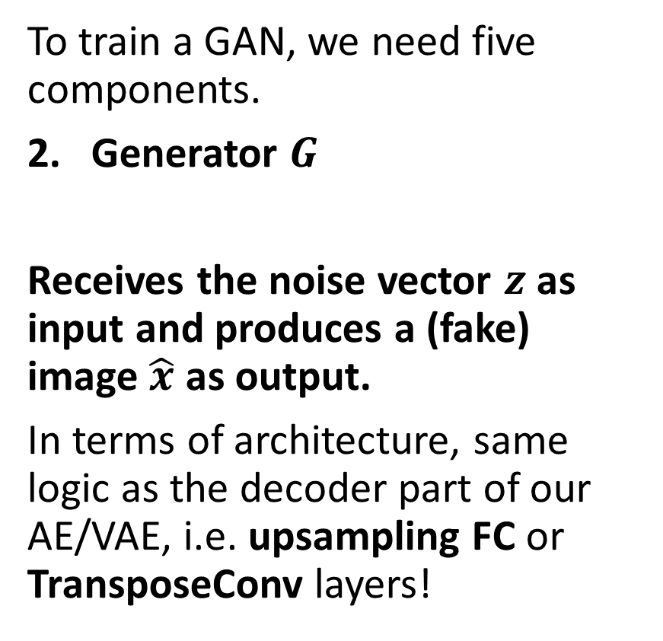
Vanilla GAN architecture
To train a GAN, we need five components.
Generator $G$
Receives the noise vector $z$ as input and produces a (fake) image $\hat{x}$ as output.
In terms of architecture, same logic as the decoder part of our AE/VAE, i.e. upsampling FC or TransposeConv layers!

Slide 9
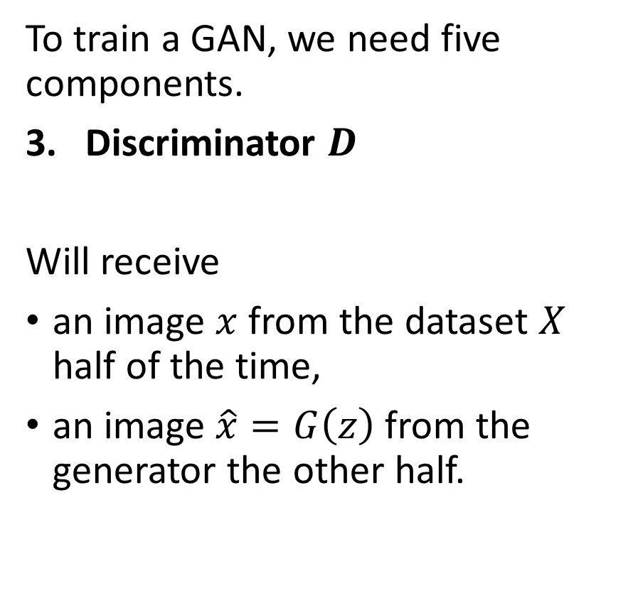
Vanilla GAN architecture
To train a GAN, we need five components.
Discriminator $D$
Will receive
an image $x$ from the dataset $X$ half of the time,
an image $\hat{x}=G\left(z\right)$ from the generator the other half.
Binary classification: needs to classify the image as fake (0) or real (1).

Slide 10
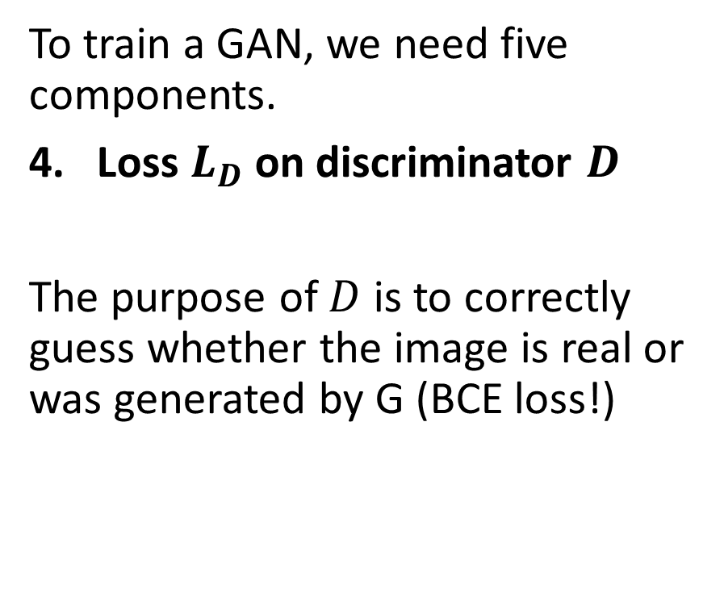
Vanilla GAN architecture
To train a GAN, we need five components.
Loss $L_{D}$on discriminator $D$
The purpose of $D$ is to correctly guess whether the image is real or was generated by G (BCE loss!)
The first component checks if the discriminator is correctly classifying the real samples.
The second component checks if the discriminator correctly classifies the fake samples.
$$L_{D}=\frac{1}{N}\sum_{x_{i}∈minibatch(X_{N})}{−\log\left(D\left(x_{i}\right)\right)}+\frac{1}{N}\sum_{z_{i}∈minibatch(N)}{−\log\left(1−D\left(G\left(z_{i}\right)\right)\right)}$$

Slide 11
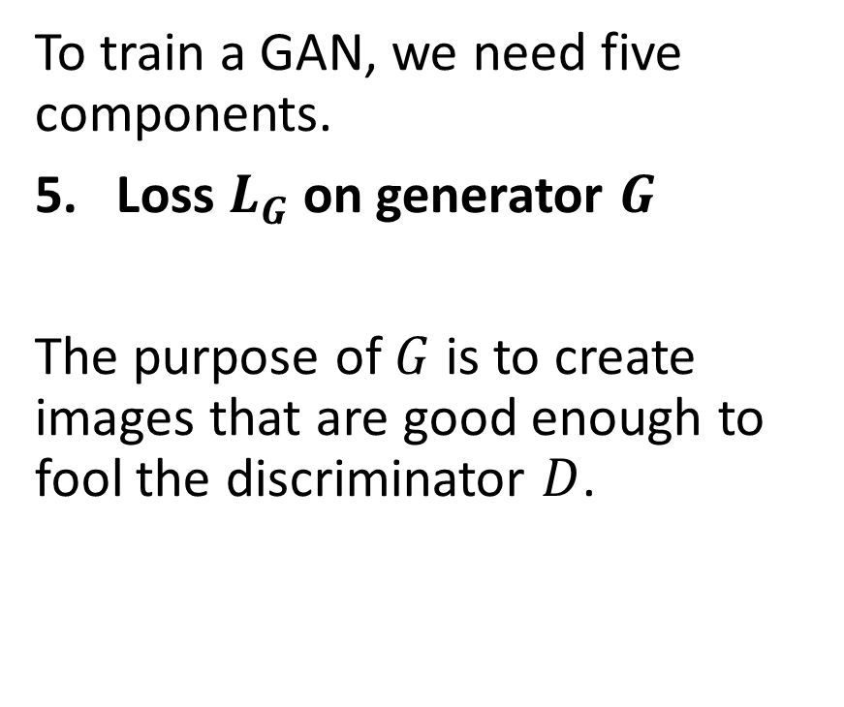
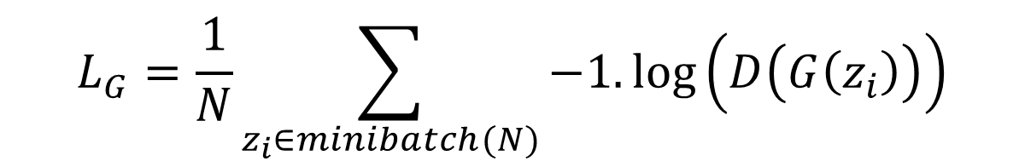
Vanilla GAN architecture
To train a GAN, we need five components.
Loss $L_{G}$on generator $G$
The purpose of $G$ is to create images that are good enough to fool the discriminator $D$.
$$L_{G}=\frac{1}{N}\sum_{z_{i}∈minibatch(N)}{−1.\log\left(D\left(G\left(z_{i}\right)\right)\right)}$$

Slide 12
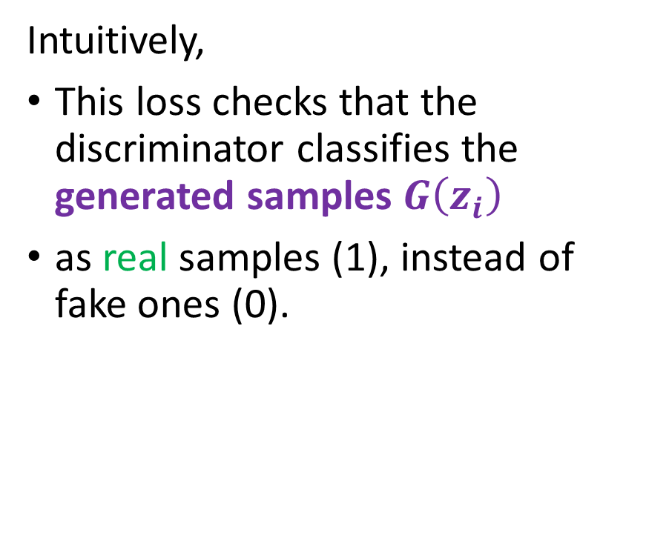
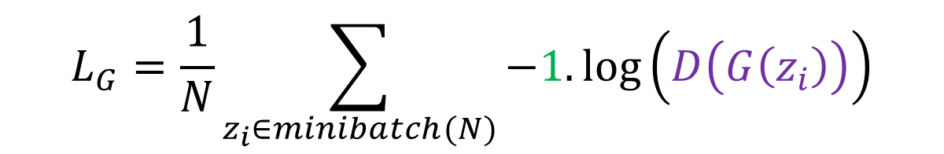
Vanilla GAN architecture
To train a GAN, we need five components.
Loss $L_{G}$on generator $G$
The purpose of $G$ is to create images that are good enough to fool the discriminator $D$.
Intuitively,
This loss checks that the discriminator classifies the generated samples $G\left(z_{i}\right)$
as real samples (1), instead of fake ones (0).
$$L_{G}=\frac{1}{N}\sum_{z_{i}∈minibatch(N)}{−1.\log\left(D\left(G\left(z_{i}\right)\right)\right)}$$

Slide 13
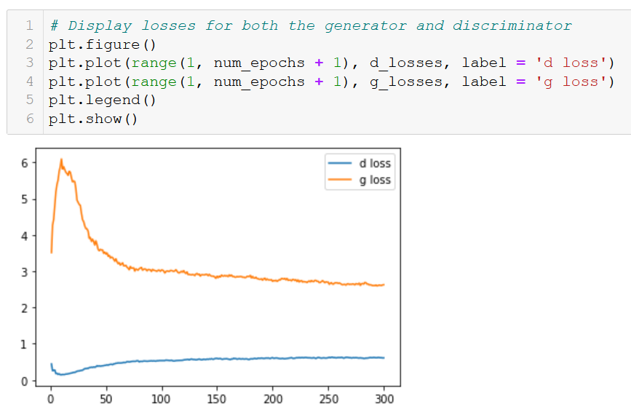
GAN training visuals
After training, we can visualize the losses.
Convergence seems to be happening on the losses.
(A few more iterations would have probably been good).

Slide 14
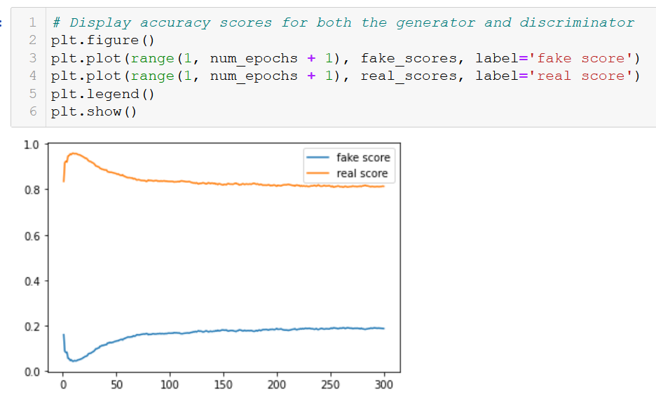
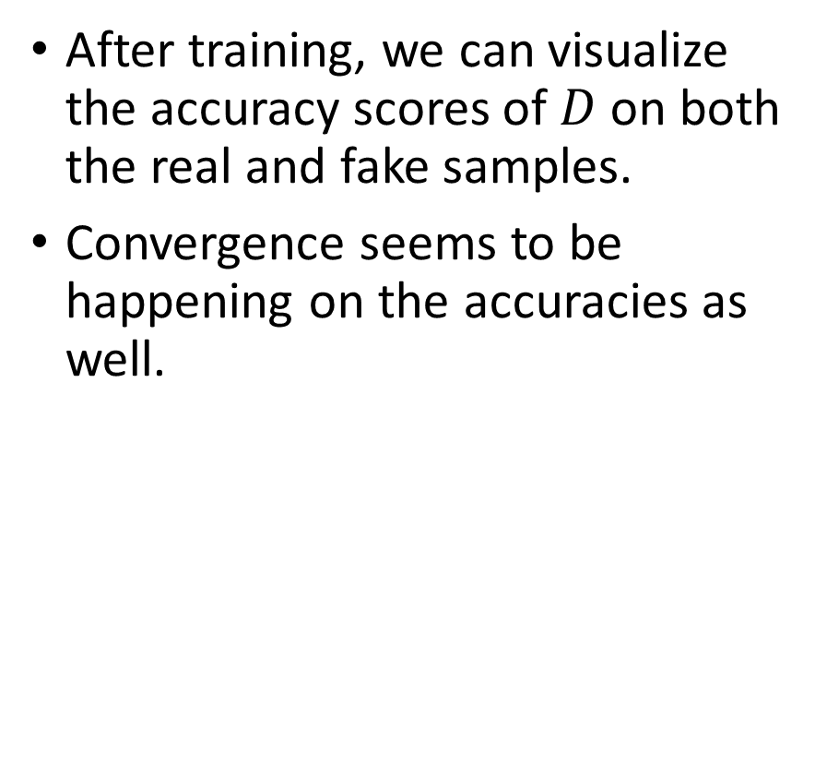
GAN training visuals
After training, we can visualize the accuracy scores of $D$ on both the real and fake samples.
Convergence seems to be happening on the accuracies as well.

Slide 15
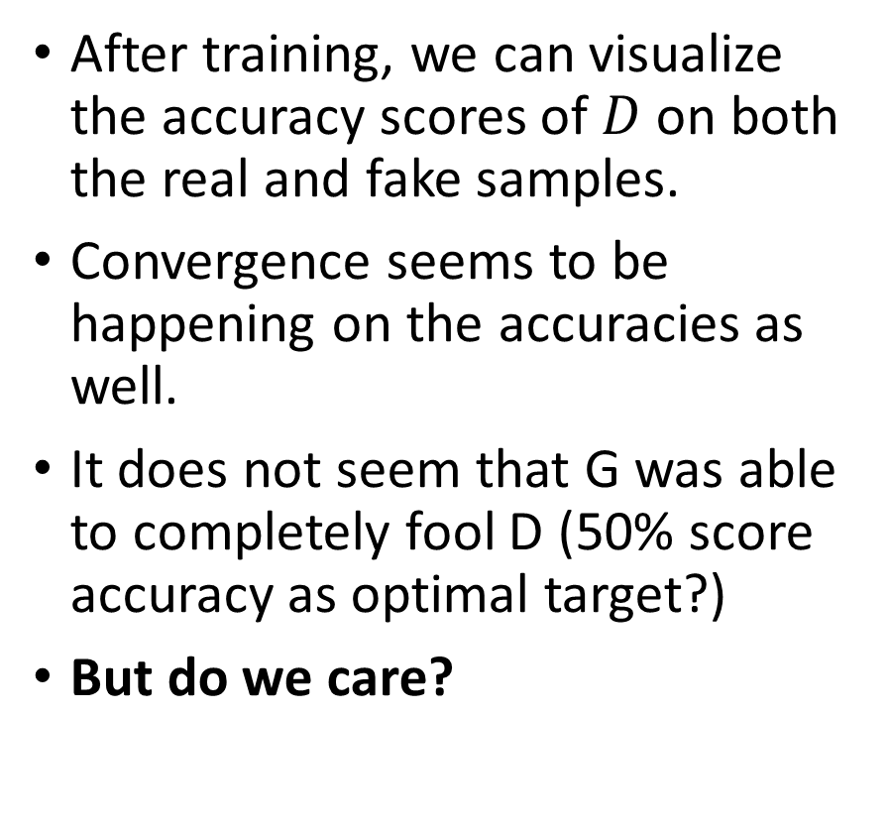
GAN training visuals
After training, we can visualize the accuracy scores of $D$ on both the real and fake samples.
Convergence seems to be happening on the accuracies as well.
It does not seem that G was able to completely fool D (50% score accuracy as optimal target?)
But do we care?

Slide 16
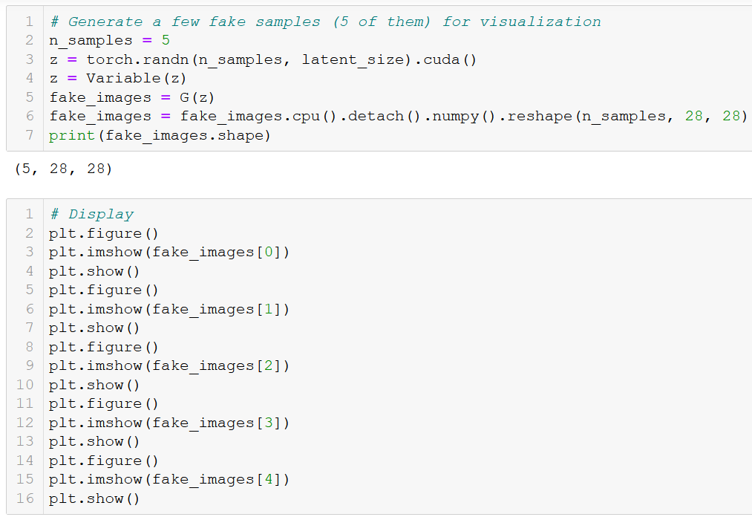
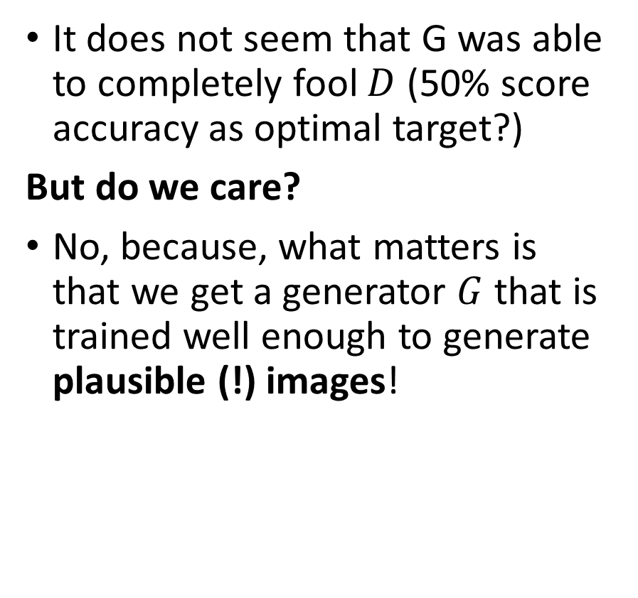
GAN training visuals
It does not seem that G was able to completely fool $D$ (50% score accuracy as optimal target?)
But do we care?
No, because, what matters is that we get a generator $G$ that is trained well enough to generate plausible (!) images!

Slide 17
GAN training visuals

Slide 18
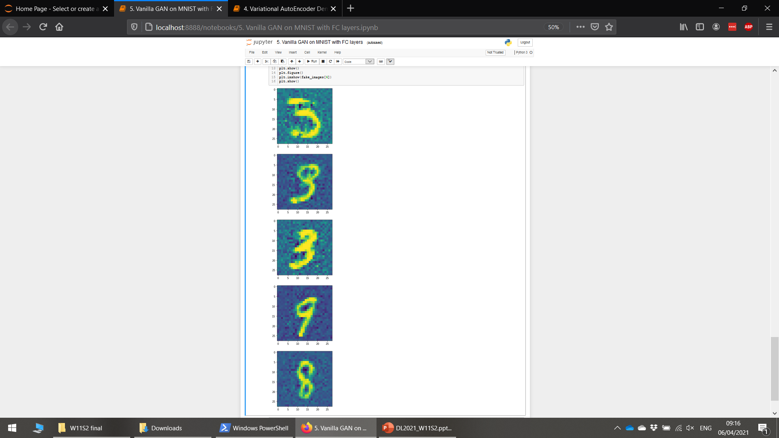
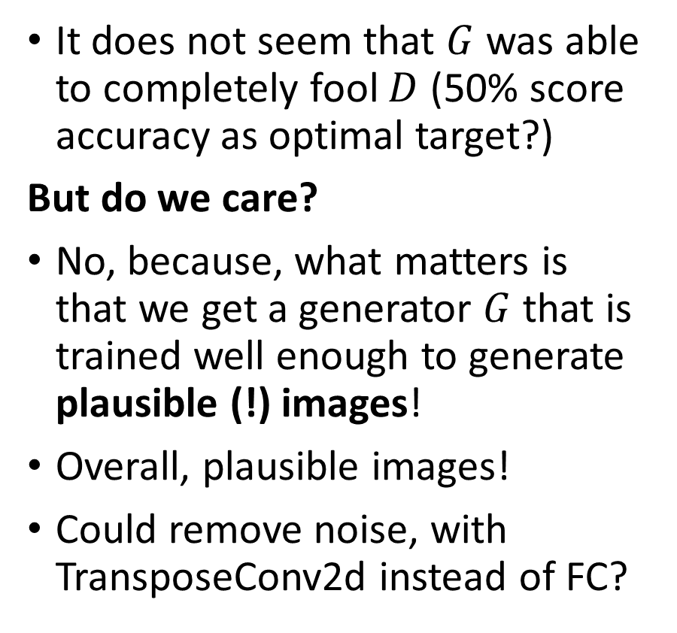
GAN training visuals
It does not seem that $G$ was able to completely fool $D$ (50% score accuracy as optimal target?)
But do we care?
No, because, what matters is that we get a generator $G$ that is trained well enough to generate plausible (!) images!
Overall, plausible images!
Could remove noise, with TransposeConv2d instead of FC?

Slide 19
Typical issues with vanilla GANs
Vanilla GANs are difficult to train for several reasons.
Reason #1 – Convergence of interleaved training is not guaranteed: we have to alternate between training the discriminator and the generator, but the convergence of said process is not guaranteed.
Reason #2 – Convergence is not necessarily the best possible outcome in terms of generator performance.
Interleaved training
Optimize discriminator strategy (train), with generator strategy fixed.
Optimize generator strategy (train), with discriminator strategy fixed.
Repeat until convergence on both players strategies (= training convergence)

Slide 20
Typical issues with vanilla GANs
Definition (Nash Equilibrium):
In game theory, a Nash Equilibrium is the most common way to define the endgame solution of a non-cooperative game involving two or more players.
The Nash equilibrium describes a situation where no player is interested to change its own strategy anymore.
Interleaved training
Optimize discriminator strategy (train), with generator strategy fixed.
Optimize generator strategy (train), with discriminator strategy fixed.
Repeat until convergence on both players strategies (= training convergence)

Slide 21
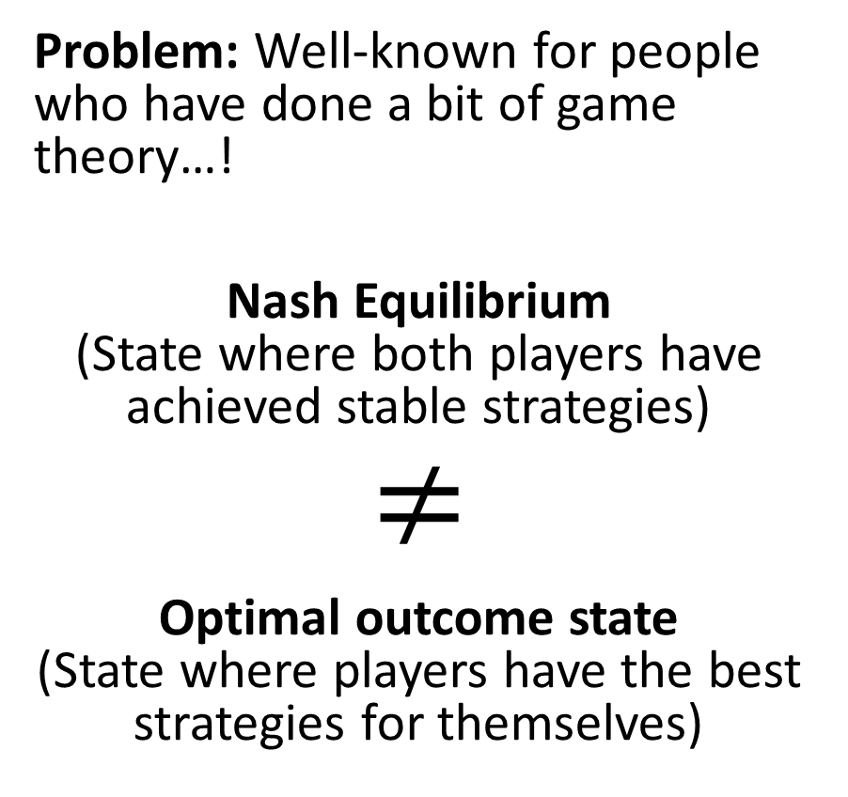
Typical issues with vanilla GANs
Problem: Well-known for people who have done a bit of game theory…!
Nash Equilibrium (State where both players have achieved stable strategies)
$$≠$$
Optimal outcome state (State where players have the best strategies for themselves)

Slide 22
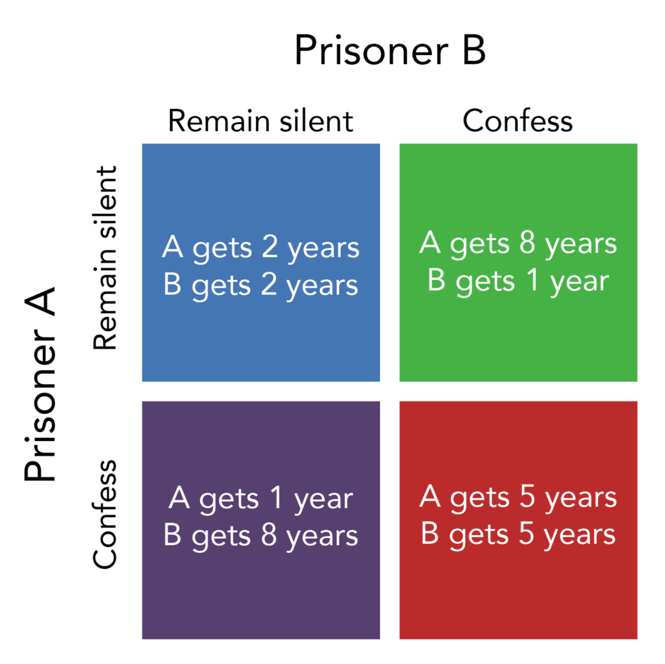
Typical issues with vanilla GANs
Counterexample: the infamous prisoner’s dilemma (two prisoners as players).
Problem: Well-known for people who have done a bit of game theory…!
Nash Equilibrium (State where both players have achieved stable strategies)
$$≠$$
Optimal outcome state (State where players have the best strategies for themselves)

Slide 23
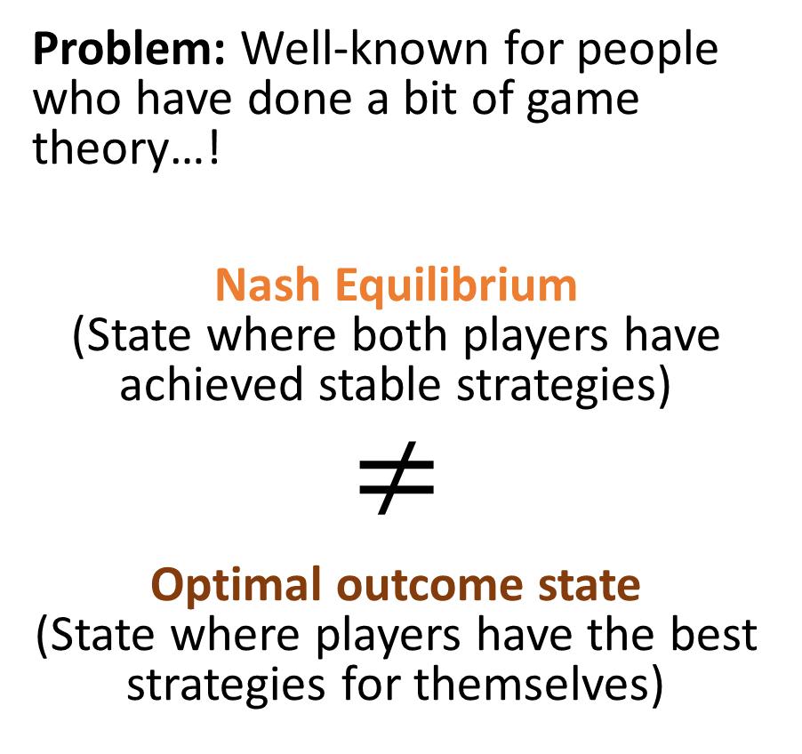
Typical issues with vanilla GANs
Counterexample: the infamous prisoner’s dilemma (two prisoners as players).
Problem: Well-known for people who have done a bit of game theory…!
Nash Equilibrium (State where both players have achieved stable strategies)
$$≠$$
Optimal outcome state (State where players have the best strategies for themselves)

Slide 24
Typical issues with vanilla GANs
Counterexample: the infamous prisoner’s dilemma (two prisoners as players).
Problem: Well-known for people who have done a bit of game theory…!
Nash Equilibrium (State where both players have achieved stable strategies)
$$≠$$
Optimal outcome state (State where players have the best strategies for themselves)

Slide 25
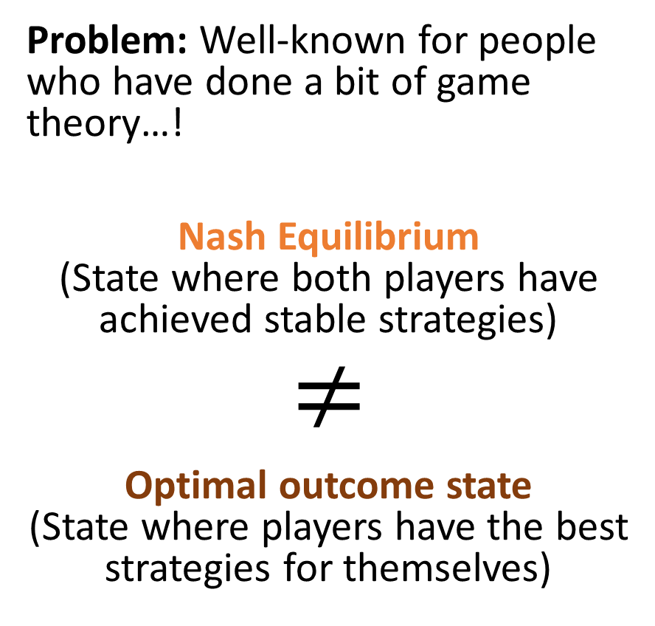
Typical issues with vanilla GANs
Counterexample: the infamous prisoner’s dilemma (two prisoners as players).
Problem: Well-known for people who have done a bit of game theory…!
Nash Equilibrium (State where both players have achieved stable strategies)
$$≠$$
Optimal outcome state (State where players have the best strategies for themselves)

Slide 26
Typical issues with vanilla GANs
Vanilla GANs are difficult to train for several reasons.
Reason #1 – Convergence of interleaved training is not guaranteed: we have to alternate between training the discriminator and the generator, but the convergence of said process is not guaranteed.
Reason #2 – Convergence is not necessarily the best possible outcome in terms of generator performance.
Interleaved training (discriminator and generator are the two players)
Optimize discriminator strategy (train), with generator strategy fixed.
Optimize generator strategy (train), with discriminator strategy fixed.
Repeat until convergence on both players strategies (= training convergence)

Slide 27
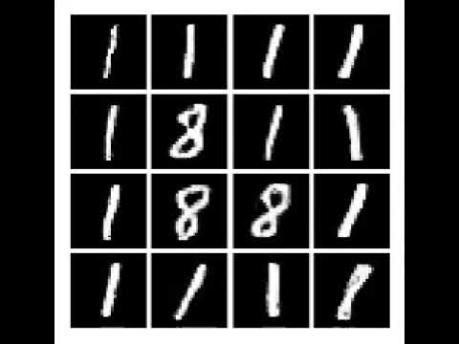
Typical issues with vanilla GANs
Vanilla GANs are difficult to train for several reasons.
Reason #3 – Mode Collapse: Mode Collapse refers to situations where the generator has identified it can very easily fool the discriminator by producing the same image (with small variations) over and over again.
This is considered a loss of generality for the generator.

Slide 28
Typical issues with vanilla GANs
Vanilla GANs are difficult to train for several reasons.
Reason #4 – Oversensitivity to (unlucky) hyperparameters settings: Something that has been empirically observed.
For more info https://jonathan-hui.medium.com/gan-why-it-is-so-hard-to-train-generative-advisory-networks-819a86b3750b

Slide 29
Typical issues with vanilla GANs
Vanilla GANs are difficult to train for several reasons.
Reason #4 – Oversensitivity to (unlucky) hyperparameters settings: Something that has been empirically observed.
For more info https://jonathan-hui.medium.com/gan-why-it-is-so-hard-to-train-generative-advisory-networks-819a86b3750b
Reason #5 – Imbalance in discriminator/generator performance: If the generator (or discriminator) is too good at its task, it might be difficult for the other model to catch up and learn properly.
One of the two models might require more training than the other to catch up!

Slide 30
Typical issues with vanilla GANs
Vanilla GANs are difficult to train for several reasons.
Reason #4 – Oversensitivity to (unlucky) hyperparameters settings: Something that has been empirically observed.
For more info https://jonathan-hui.medium.com/gan-why-it-is-so-hard-to-train-generative-advisory-networks-819a86b3750b
Reason #5 – Imbalance in discriminator/generator performance: If the generator (or discriminator) is too good at its task, it might be difficult for the other model to catch up and learn properly.
One of the two models might require more training than the other to catch up!
Especially true when generator is bad at making images!

Slide 31
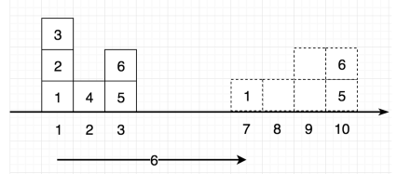
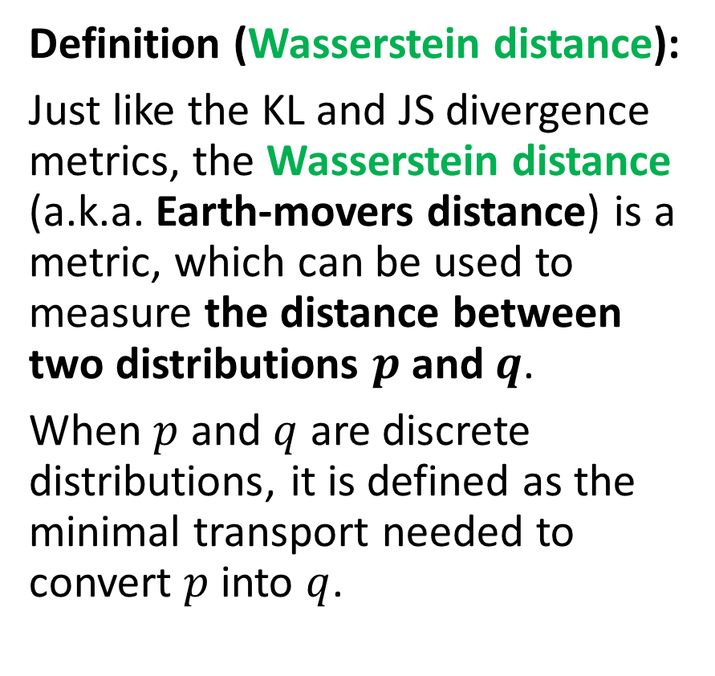
Definition: Wasserstein distance
Definition (Wasserstein distance):
Just like the KL and JS divergence metrics, the Wasserstein distance (a.k.a. Earth-movers distance) is a metric, which can be used to measure the distance between two distributions $p$ and $q$.
When $p$ and $q$ are discrete distributions, it is defined as the minimal transport needed to convert $p$ into $q$.
p
q

Slide 32
Definition: Wasserstein distance
Definition (Wasserstein distance):
Just like the KL and JS divergence metrics, the Wasserstein distance (a.k.a. Earth-movers distance) is a metric, which can be used to measure the distance between two distributions $p$ and $q$.
When $p$ and $q$ are discrete distributions, it is defined as the minimal transport needed to convert $p$ into $q$.
p
q

Slide 33
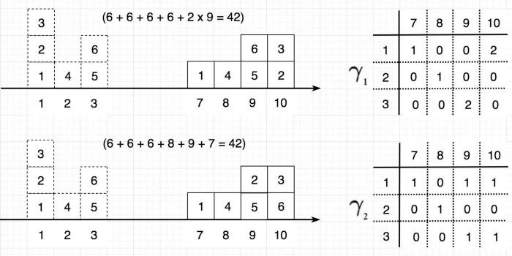
Definition: Wasserstein distance
Definition (Wasserstein distance):
Just like the KL and JS divergence metrics, the Wasserstein distance (a.k.a. Earth-movers distance) is a metric, which can be used to measure the distance between two distributions $p$ and $q$.
When $p$ and $q$ are discrete distributions, it is defined as the minimal transport needed to convert $p$ into $q$.

Slide 34
Definition: Wasserstein distance
Definition (Wasserstein distance):
Just like the KL and JS divergence metrics, the Wasserstein distance (a.k.a. Earth-movers distance) is a metric, which can be used to measure the distance between two distributions $p$ and $q$.
When $p$ and $q$ are discrete distributions, it is defined as the minimal transport needed to convert $p$ into $q$.

Slide 35
Definition: Wasserstein distance
Definition (Wasserstein distance):
Just like the KL and JS divergence metrics, the Wasserstein distance (a.k.a. Earth-movers distance) is a metric, which can be used to measure the distance between two distributions $p$ and $q$.
When $p$ and $q$ are discrete distributions, it is defined as the minimal transport needed to convert $p$ into $q$.
How to solve this optimization problem?

Slide 36
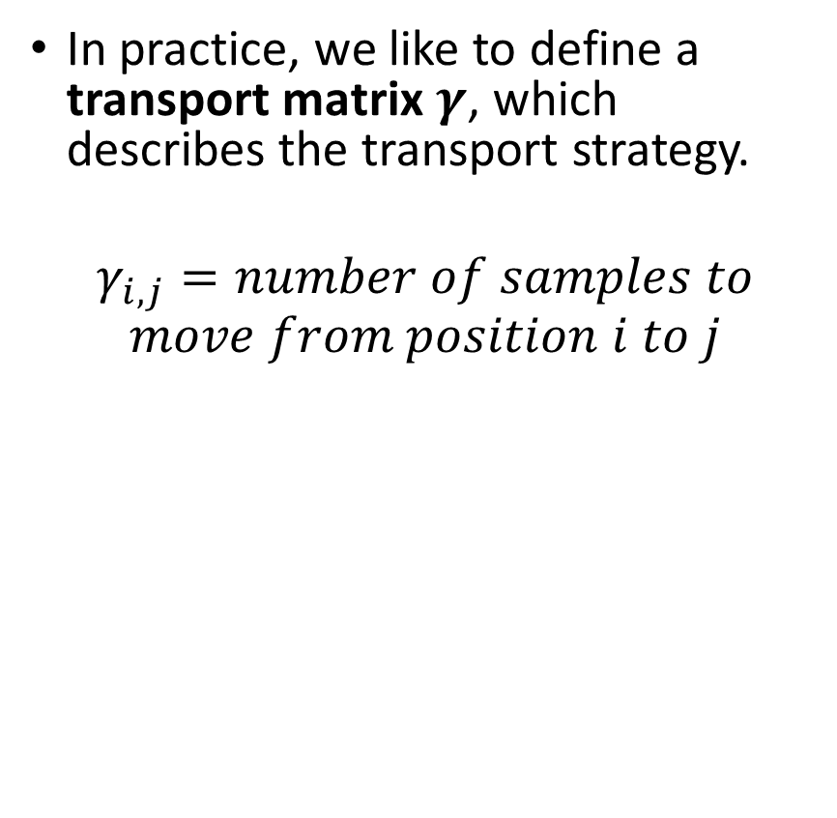
Definition: Wasserstein distance
In practice, we like to define a transport matrix $γ$, which describes the transport strategy.
$$γ_{i,j}=number of samples to \\ move from position i to j$$
The distance $d_{γ(p,q)}$ for a strategy $γ$ is then simply defined as
$$d_{γ(p,q)}=\sum_{i,j}{γ_{i,j}}{\left\|i−j\right\|}_{2}$$

Slide 37
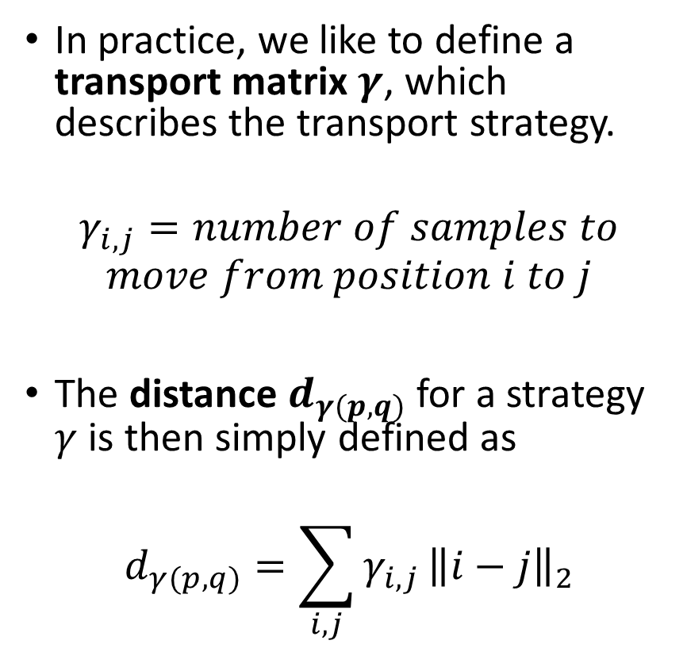
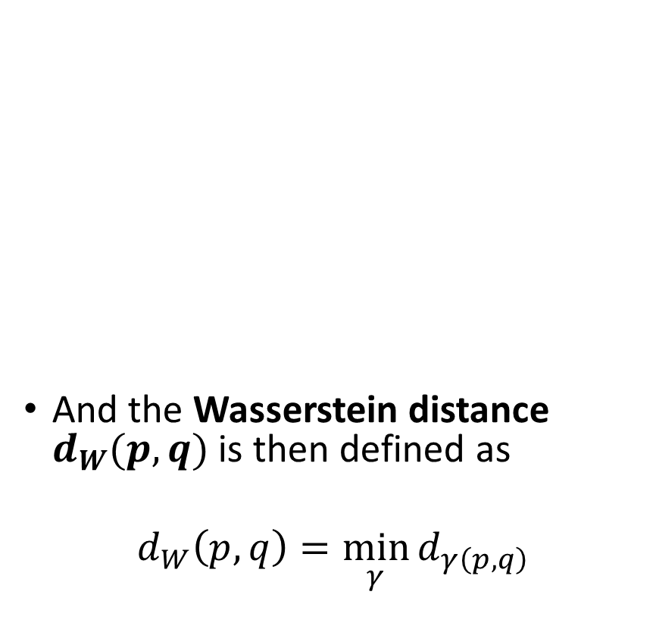
Definition: Wasserstein distance
In practice, we like to define a transport matrix $γ$, which describes the transport strategy.
$$γ_{i,j}=number of samples to \\ move from position i to j$$
The distance $d_{γ(p,q)}$ for a strategy $γ$ is then simply defined as
$$d_{γ(p,q)}=\sum_{i,j}{γ_{i,j}}{\left\|i−j\right\|}_{2}$$
And the Wasserstein distance $d_{W}(p,q)$ is then defined as
$$d_{W}\left(p,q\right)=\min_{γ}{d_{γ\left(p,q\right)}}$$

Slide 38
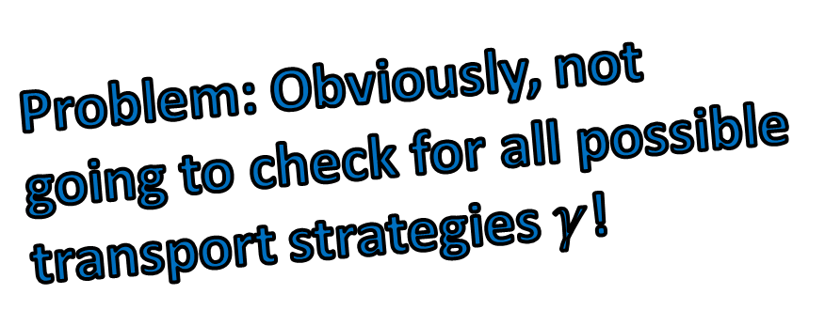
Definition: Wasserstein distance
In practice, we like to define a transport matrix $γ$, which describes the transport strategy.
$$γ_{i,j}=number of samples to \\ move from position i to j$$
The distance $d_{γ(p,q)}$ for a strategy $γ$ is then simply defined as
$$d_{γ(p,q)}=\sum_{i,j}{γ_{i,j}}{\left\|i−j\right\|}_{2}$$
And the Wasserstein distance $d_{W}(p,q)$ is then defined as
$$d_{W}\left(p,q\right)=\min_{γ}{d_{γ\left(p,q\right)}}$$
Problem: Obviously, not going to check for all possible transport strategies $γ$!

Slide 39
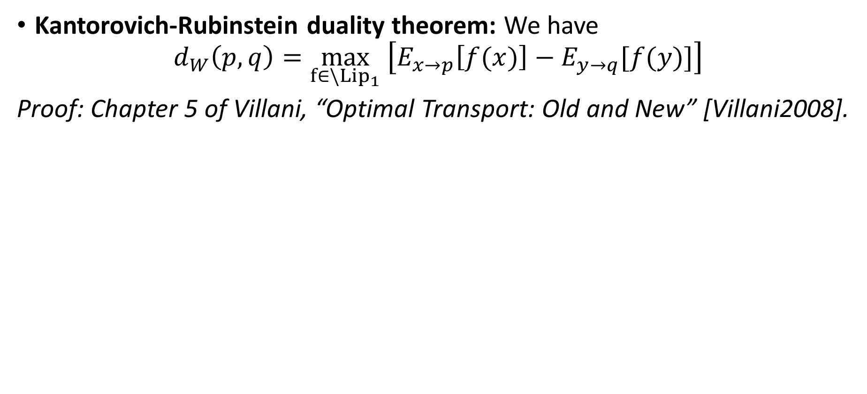
Definition: Wasserstein distance
Kantorovich-Rubinstein duality theorem: We have
$$d_{W}\left(p,q\right)=\max_{f∈\backslash {Lip}_{1}} \left[E_{x→p}\left[f(x)\right]−E_{y→q}[f(y)]\right]$$
Proof: Chapter 5 of Villani, “Optimal Transport: Old and New” [Villani2008].

Slide 40
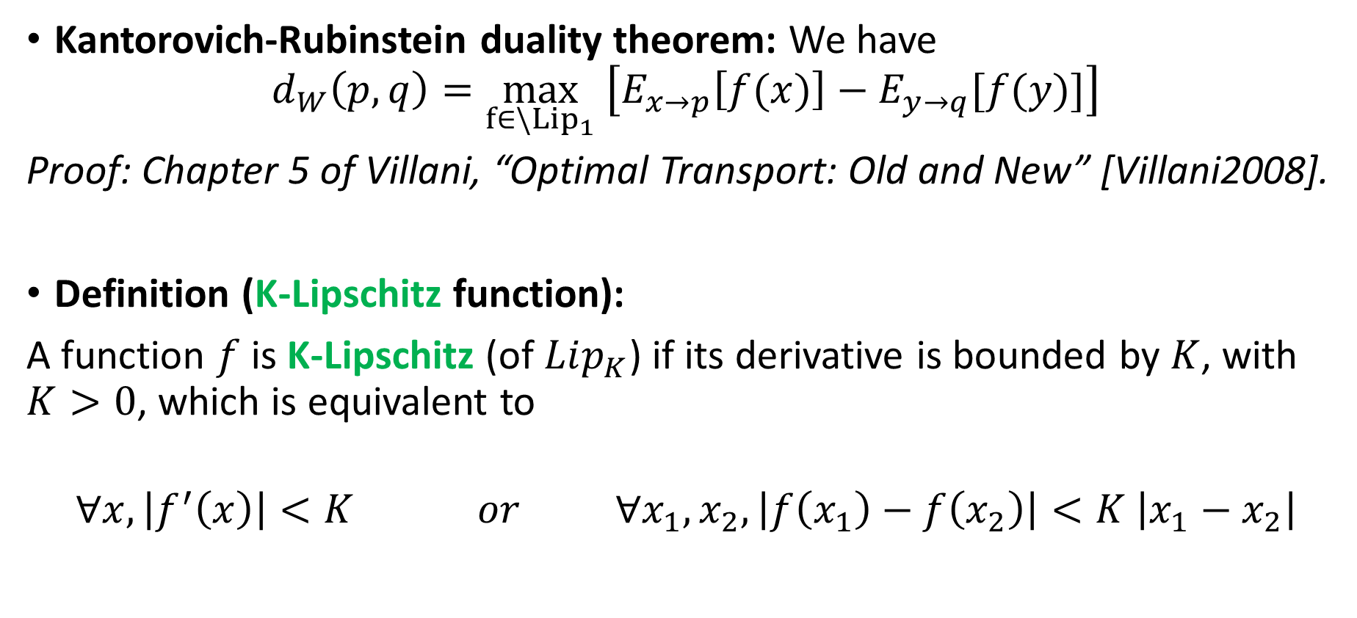
Definition: Wasserstein distance
Kantorovich-Rubinstein duality theorem: We have
$$d_{W}\left(p,q\right)=\max_{f∈\backslash {Lip}_{1}} \left[E_{x→p}\left[f(x)\right]−E_{y→q}[f(y)]\right]$$
Proof: Chapter 5 of Villani, “Optimal Transport: Old and New” [Villani2008].
Definition (K-Lipschitz function):
A function $f$ is K-Lipschitz (of $Lip_{K}$) if its derivative is bounded by $K$, with $K>0$, which is equivalent to
$$∀x, \left|f^{′}\left(x\right)\right|<K or ∀x_{1},x_{2},\left|f\left(x_{1}\right)−f\left(x_{2}\right)\right|<K \left|x_{1}−x_{2}\right|$$

Slide 41
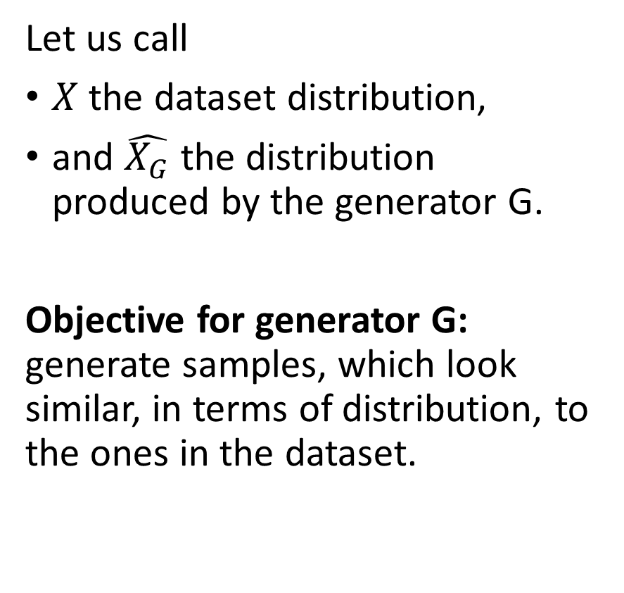
Wasserstein GAN idea
Let us call
$X$ the dataset distribution,
and $\hat{X_{G}}$ the distribution produced by the generator G.
Objective for generator G: generate samples, which look similar, in terms of distribution, to the ones in the dataset.

Slide 42
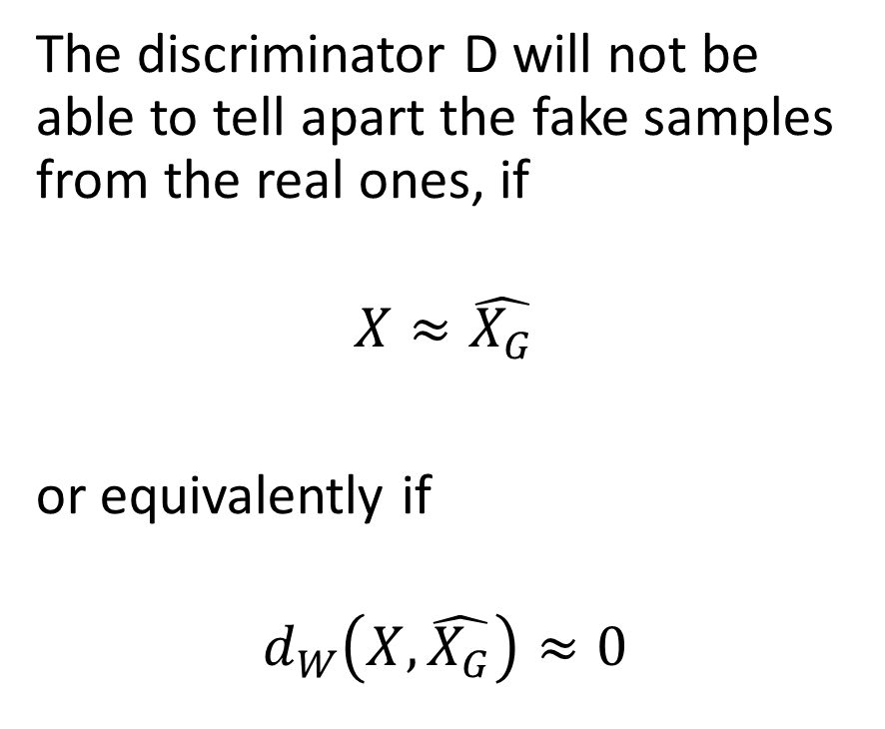
Wasserstein GAN idea
Let us call
$X$ the dataset distribution,
and $\hat{X_{G}}$ the distribution produced by the generator G.
Objective for generator G: generate samples, which look similar, in terms of distribution, to the ones in the dataset.
The discriminator D will not be able to tell apart the fake samples from the real ones, if
$$X≈\hat{X_{G}}$$
or equivalently if
$$d_{W}\left(X,\hat{X_{G}}\right)≈0$$

Slide 43
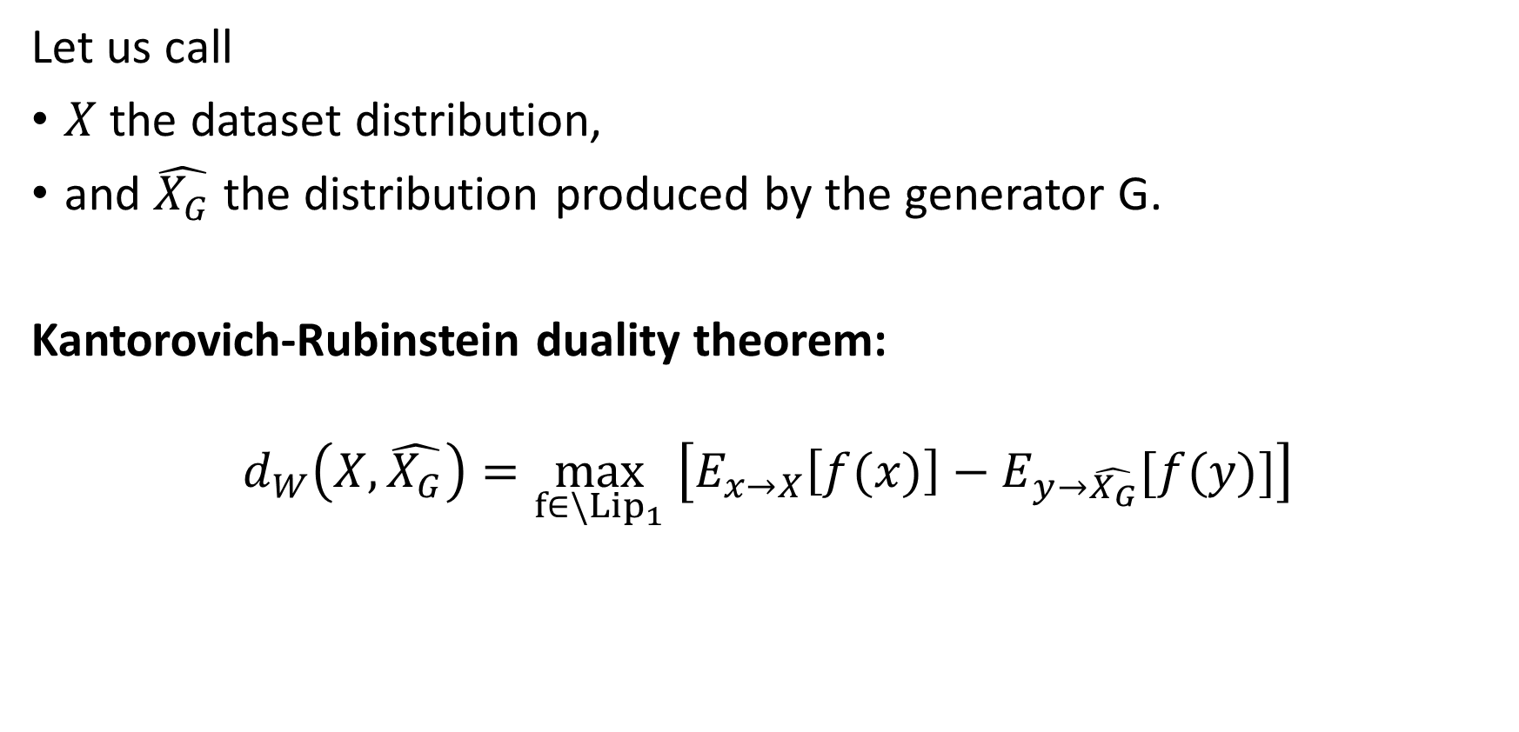
Wasserstein GAN idea
Let us call
$X$ the dataset distribution,
and $\hat{X_{G}}$ the distribution produced by the generator G.
Kantorovich-Rubinstein duality theorem:
$$d_{W}\left(X,\hat{X_{G}}\right)=\max_{f∈\backslash {Lip}_{1}} \left[E_{x→X}\left[f(x)\right]−E_{y→\hat{X_{G}}}[f(y)]\right]$$

Slide 44
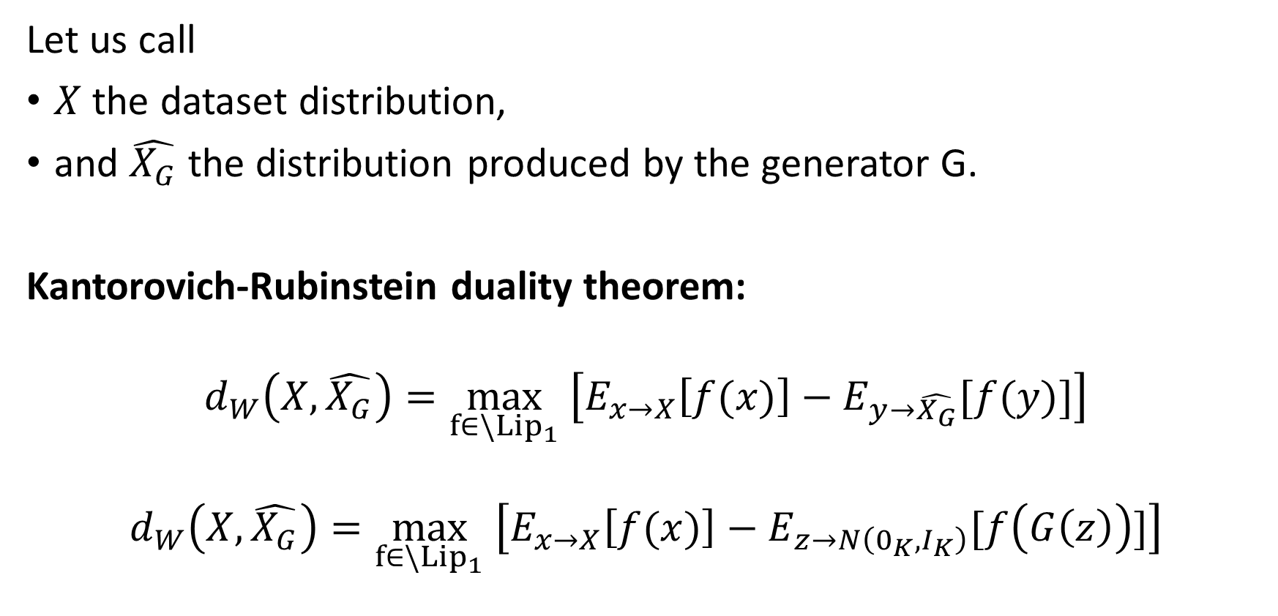
Wasserstein GAN idea
Let us call
$X$ the dataset distribution,
and $\hat{X_{G}}$ the distribution produced by the generator G.
Kantorovich-Rubinstein duality theorem:
$$d_{W}\left(X,\hat{X_{G}}\right)=\max_{f∈\backslash {Lip}_{1}} \left[E_{x→X}\left[f(x)\right]−E_{y→\hat{X_{G}}}[f(y)]\right]$$
$$d_{W}\left(X,\hat{X_{G}}\right)=\max_{f∈\backslash {Lip}_{1}} \left[E_{x→X}\left[f(x)\right]−E_{z→N\left(0_{K},I_{K}\right)}[f\left(G\left(z\right)\right)]\right]$$

Slide 45
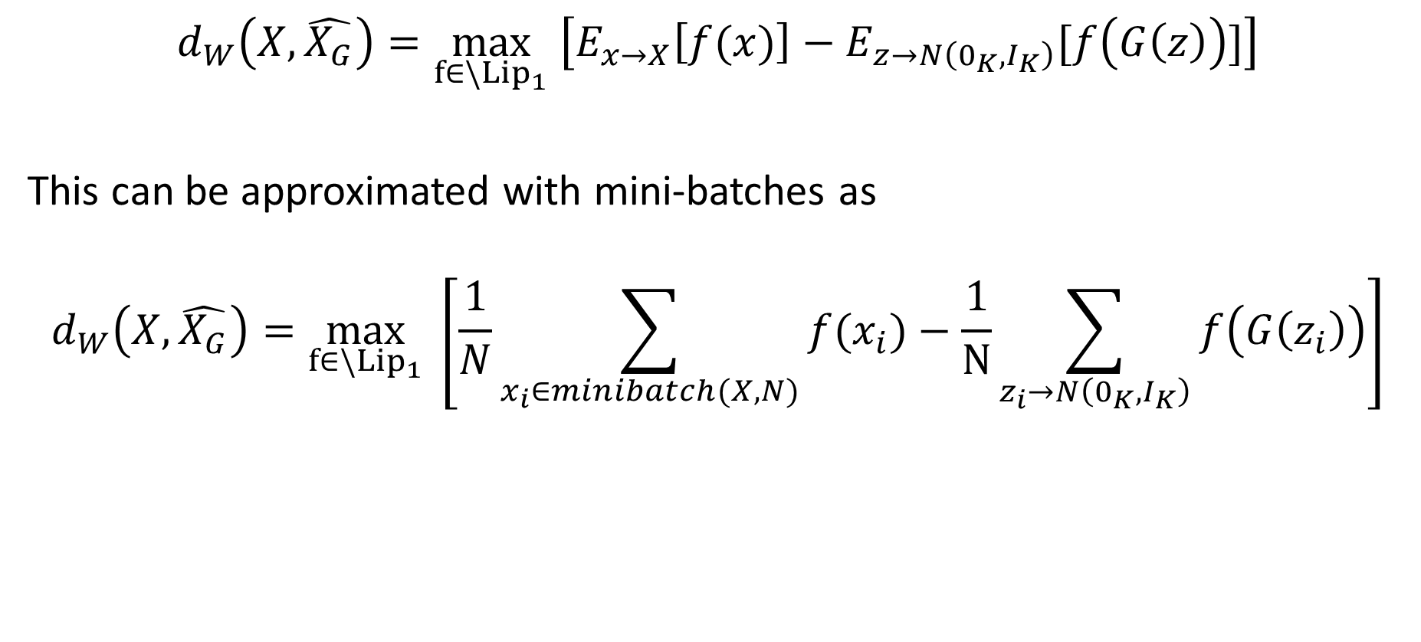
Wasserstein GAN idea
$$d_{W}\left(X,\hat{X_{G}}\right)=\max_{f∈\backslash {Lip}_{1}} \left[E_{x→X}\left[f(x)\right]−E_{z→N\left(0_{K},I_{K}\right)}[f\left(G\left(z\right)\right)]\right]$$
This can be approximated with mini-batches as
$$d_{W}\left(X,\hat{X_{G}}\right)=\max_{f∈\backslash {Lip}_{1}} \left[\frac{1}{N}\sum_{x_{i}∈minibatch(X,N)}{f(x_{i})}−\frac{1}{N}\sum_{z_{i}→N\left(0_{K},I_{K}\right)}{f\left(G\left(z_{i}\right)\right)}\right]$$

Slide 46
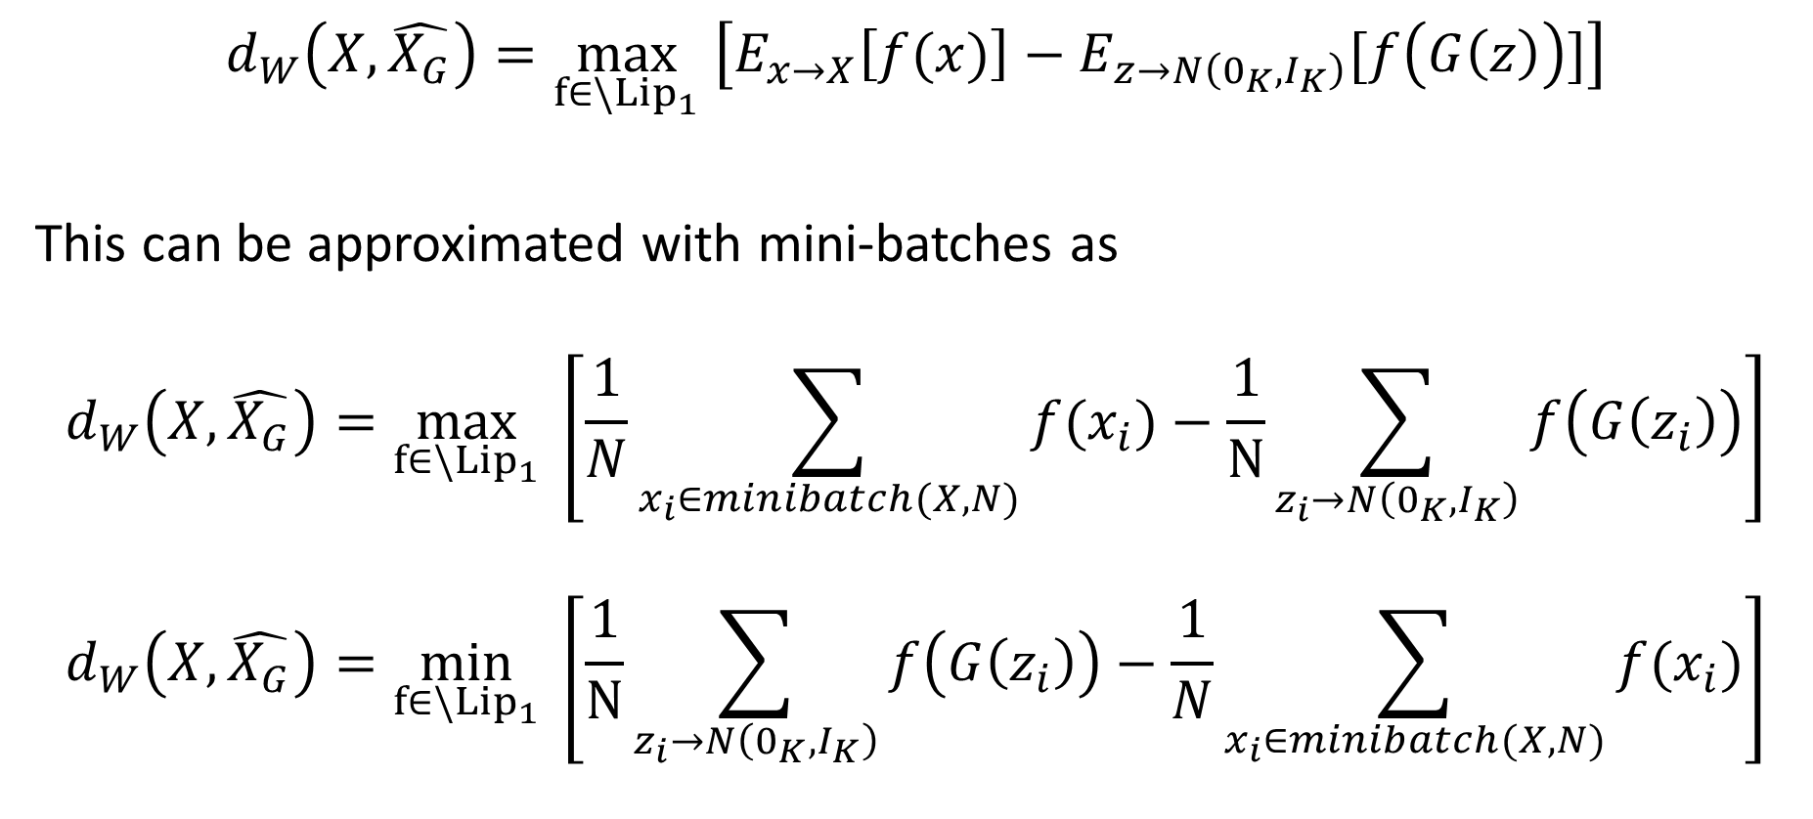
Wasserstein GAN idea
$$d_{W}\left(X,\hat{X_{G}}\right)=\max_{f∈\backslash {Lip}_{1}} \left[E_{x→X}\left[f(x)\right]−E_{z→N\left(0_{K},I_{K}\right)}[f\left(G\left(z\right)\right)]\right]$$
This can be approximated with mini-batches as
$$d_{W}\left(X,\hat{X_{G}}\right)=\max_{f∈\backslash {Lip}_{1}} \left[\frac{1}{N}\sum_{x_{i}∈minibatch(X,N)}{f(x_{i})}−\frac{1}{N}\sum_{z_{i}→N\left(0_{K},I_{K}\right)}{f\left(G\left(z_{i}\right)\right)}\right]$$
$$d_{W}\left(X,\hat{X_{G}}\right)=\min_{f∈\backslash {Lip}_{1}} \left[\frac{1}{N}\sum_{z_{i}→N\left(0_{K},I_{K}\right)}{f\left(G\left(z_{i}\right)\right)}−\frac{1}{N}\sum_{x_{i}∈minibatch(X,N)}{f(x_{i})}\right]$$

Slide 47
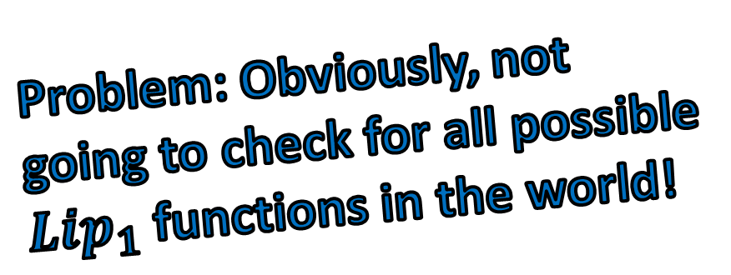
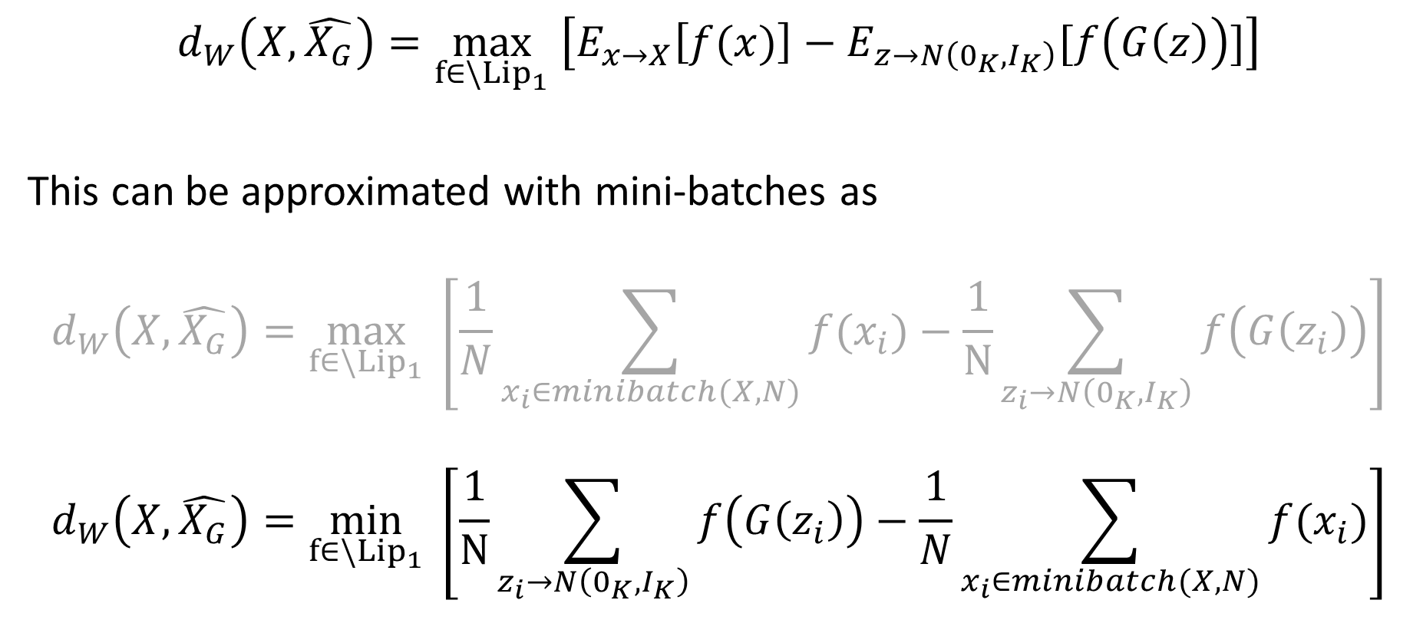
Wasserstein GAN idea
$$d_{W}\left(X,\hat{X_{G}}\right)=\max_{f∈\backslash {Lip}_{1}} \left[E_{x→X}\left[f(x)\right]−E_{z→N\left(0_{K},I_{K}\right)}[f\left(G\left(z\right)\right)]\right]$$
This can be approximated with mini-batches as
$$d_{W}\left(X,\hat{X_{G}}\right)=\max_{f∈\backslash {Lip}_{1}} \left[\frac{1}{N}\sum_{x_{i}∈minibatch(X,N)}{f(x_{i})}−\frac{1}{N}\sum_{z_{i}→N\left(0_{K},I_{K}\right)}{f\left(G\left(z_{i}\right)\right)}\right]$$
$$d_{W}\left(X,\hat{X_{G}}\right)=\min_{f∈\backslash {Lip}_{1}} \left[\frac{1}{N}\sum_{z_{i}→N\left(0_{K},I_{K}\right)}{f\left(G\left(z_{i}\right)\right)}−\frac{1}{N}\sum_{x_{i}∈minibatch(X,N)}{f(x_{i})}\right]$$
Problem: Obviously, not going to check for all possible $Lip_{1}$ functions in the world!

Slide 48
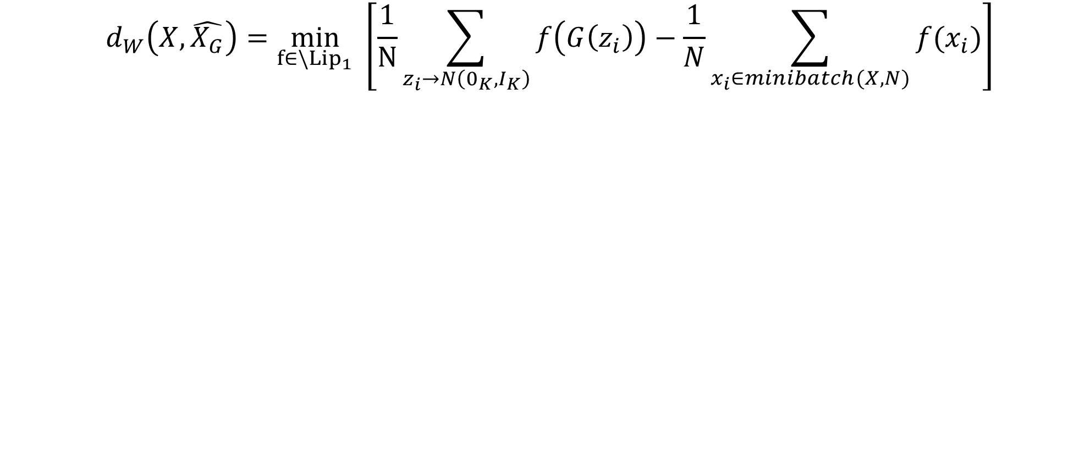
Wasserstein GAN idea
$$d_{W}\left(X,\hat{X_{G}}\right)=\min_{f∈\backslash {Lip}_{1}} \left[\frac{1}{N}\sum_{z_{i}→N\left(0_{K},I_{K}\right)}{f\left(G\left(z_{i}\right)\right)}−\frac{1}{N}\sum_{x_{i}∈minibatch(X,N)}{f(x_{i})}\right]$$
If we replace f with a Neural Network of some sort, then we could compute $d_{W}\left(X,\hat{X_{G}}\right)$ by loss minimization of said network!
$$L_{f}=\left[\frac{1}{N}\sum_{z_{i}→N\left(0_{K},I_{K}\right)}{f\left(G\left(z_{i}\right)\right)}−\frac{1}{N}\sum_{x_{i}∈minibatch(X,N)}{f(x_{i})}\right]+λR(f)$$
$$R\left(f\right)=\frac{1}{N}\sum_{z_{i}→N\left(0_{K},I_{K}\right)}{\max\left(0,{\left(\left|∇f\left(z_{i}\right)\right|−1\right)}^{2}\right) }$$

Slide 49
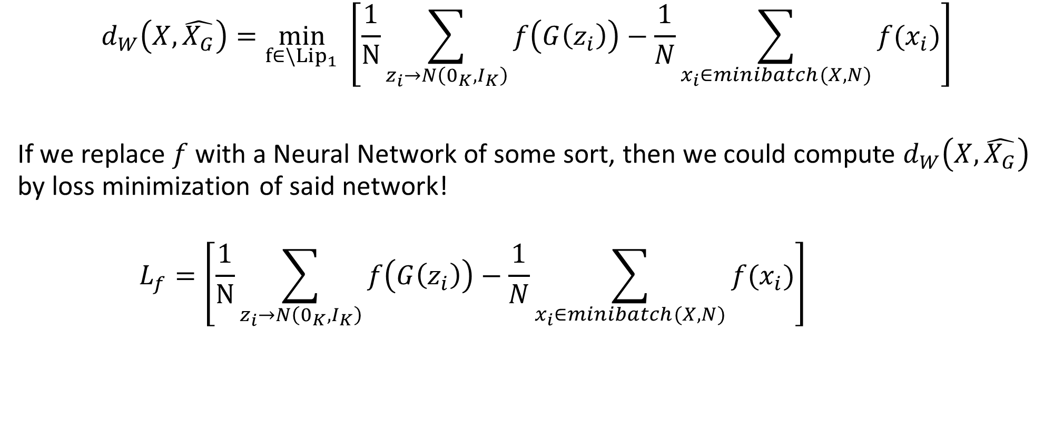
Wasserstein GAN idea
$$d_{W}\left(X,\hat{X_{G}}\right)=\min_{f∈\backslash {Lip}_{1}} \left[\frac{1}{N}\sum_{z_{i}→N\left(0_{K},I_{K}\right)}{f\left(G\left(z_{i}\right)\right)}−\frac{1}{N}\sum_{x_{i}∈minibatch(X,N)}{f(x_{i})}\right]$$
If we replace $f$ with a Neural Network of some sort, then we could compute $d_{W}\left(X,\hat{X_{G}}\right)$ by loss minimization of said network!
$$L_{f}=\left[\frac{1}{N}\sum_{z_{i}→N\left(0_{K},I_{K}\right)}{f\left(G\left(z_{i}\right)\right)}−\frac{1}{N}\sum_{x_{i}∈minibatch(X,N)}{f(x_{i})}\right]+λR(f)$$
$$R\left(f\right)=a regularization term penalizing f$$
$$if its gradients are more than 1$$

Slide 50
Wasserstein GAN idea
$$d_{W}\left(X,\hat{X_{G}}\right)=\min_{f∈\backslash {Lip}_{1}} \left[\frac{1}{N}\sum_{z_{i}→N\left(0_{K},I_{K}\right)}{f\left(G\left(z_{i}\right)\right)}−\frac{1}{N}\sum_{x_{i}∈minibatch(X,N)}{f(x_{i})}\right]$$
If we replace $f$ with a Neural Network of some sort, then we could compute $d_{W}\left(X,\hat{X_{G}}\right)$ by loss minimization of said network!
$$L_{f}=\left[\frac{1}{N}\sum_{z_{i}→N\left(0_{K},I_{K}\right)}{f\left(G\left(z_{i}\right)\right)}−\frac{1}{N}\sum_{x_{i}∈minibatch(X,N)}{f(x_{i})}\right]+λR(f)$$
$$R\left(f\right)=a regularization term penalizing f$$
$$if its gradients are more than 1$$

Slide 51
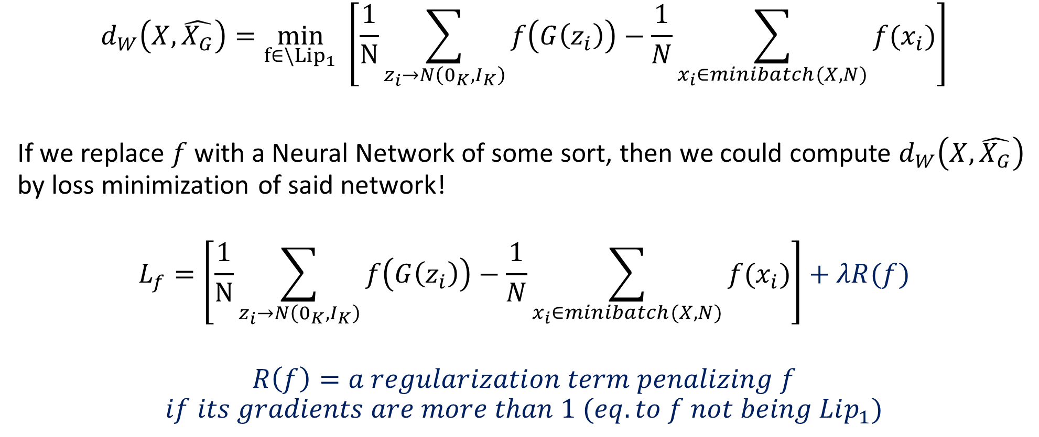
Wasserstein GAN idea
$$d_{W}\left(X,\hat{X_{G}}\right)=\min_{f∈\backslash {Lip}_{1}} \left[\frac{1}{N}\sum_{z_{i}→N\left(0_{K},I_{K}\right)}{f\left(G\left(z_{i}\right)\right)}−\frac{1}{N}\sum_{x_{i}∈minibatch(X,N)}{f(x_{i})}\right]$$
If we replace $f$ with a Neural Network of some sort, then we could compute $d_{W}\left(X,\hat{X_{G}}\right)$ by loss minimization of said network!
$$L_{f}=\left[\frac{1}{N}\sum_{z_{i}→N\left(0_{K},I_{K}\right)}{f\left(G\left(z_{i}\right)\right)}−\frac{1}{N}\sum_{x_{i}∈minibatch(X,N)}{f(x_{i})}\right]+λR(f)$$
$$R\left(f\right)=a regularization term penalizing f$$
$$if its gradients are more than 1 (eq. to f not being Lip_{1})$$

Slide 52
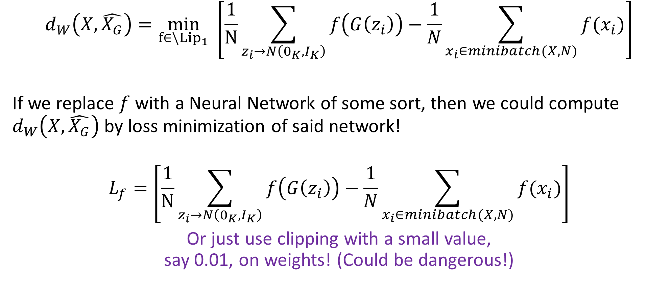
Wasserstein GAN idea
$$d_{W}\left(X,\hat{X_{G}}\right)=\min_{f∈\backslash {Lip}_{1}} \left[\frac{1}{N}\sum_{z_{i}→N\left(0_{K},I_{K}\right)}{f\left(G\left(z_{i}\right)\right)}−\frac{1}{N}\sum_{x_{i}∈minibatch(X,N)}{f(x_{i})}\right]$$
If we replace $f$ with a Neural Network of some sort, then we could compute $d_{W}\left(X,\hat{X_{G}}\right)$ by loss minimization of said network!
$$L_{f}=\left[\frac{1}{N}\sum_{z_{i}→N\left(0_{K},I_{K}\right)}{f\left(G\left(z_{i}\right)\right)}−\frac{1}{N}\sum_{x_{i}∈minibatch(X,N)}{f(x_{i})}\right]$$
Or just use clipping with a small value, say 0.01, on weights! (Could be dangerous!)

Slide 53
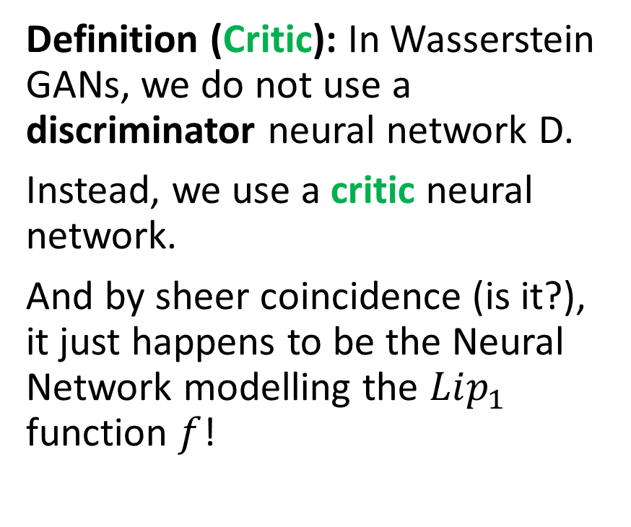
Wasserstein GAN idea
Definition (Critic): In Wasserstein GANs, we do not use a discriminator neural network D.
Instead, we use a critic neural network.
And by sheer coincidence (is it?), it just happens to be the Neural Network modelling the $Lip_{1}$ function $f$!
Real samples
Critic f
Generator G
Noise samples

Slide 54
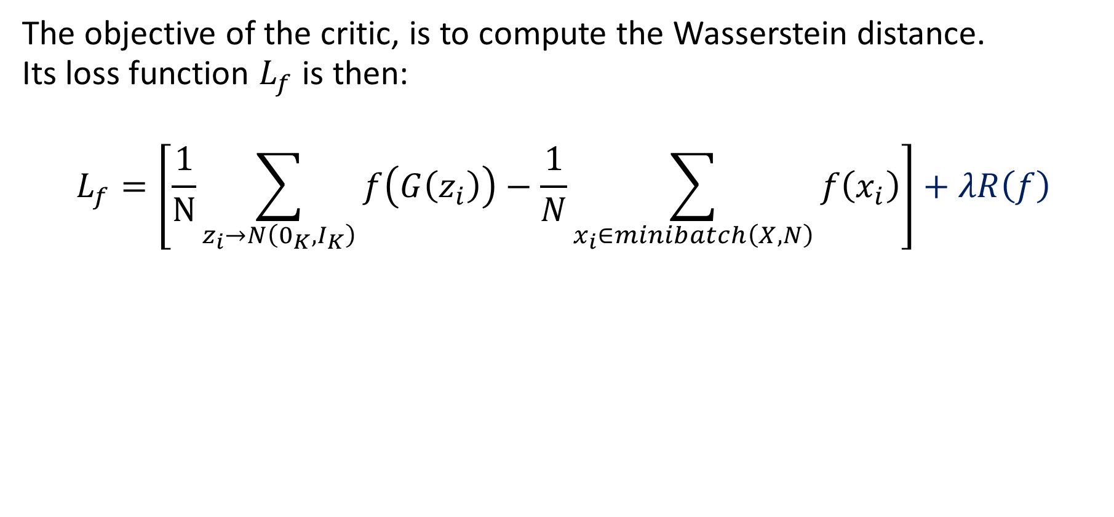
Wasserstein GAN idea
The objective of the critic, is to compute the Wasserstein distance. Its loss function $L_{f}$ is then:
$$L_{f}=\left[\frac{1}{N}\sum_{z_{i}→N\left(0_{K},I_{K}\right)}{f\left(G\left(z_{i}\right)\right)}−\frac{1}{N}\sum_{x_{i}∈minibatch\left(X,N\right)}{f\left(x_{i}\right)}\right]+λR\left(f\right)$$
$$R\left(f\right)=\frac{1}{N}\sum_{z_{i}→N\left(0_{K},I_{K}\right)}{\max\left(0,{\left(\left|∇f\left(z_{i}\right)\right|−1\right)}^{2}\right)}$$
$$+\frac{1}{N}\sum_{x_i∈minibatch(X,N)}{\max\left(0,{\left(\left|∇f\left(x_{i}\right)\right|−1\right)}^{2}\right) }$$

Slide 55
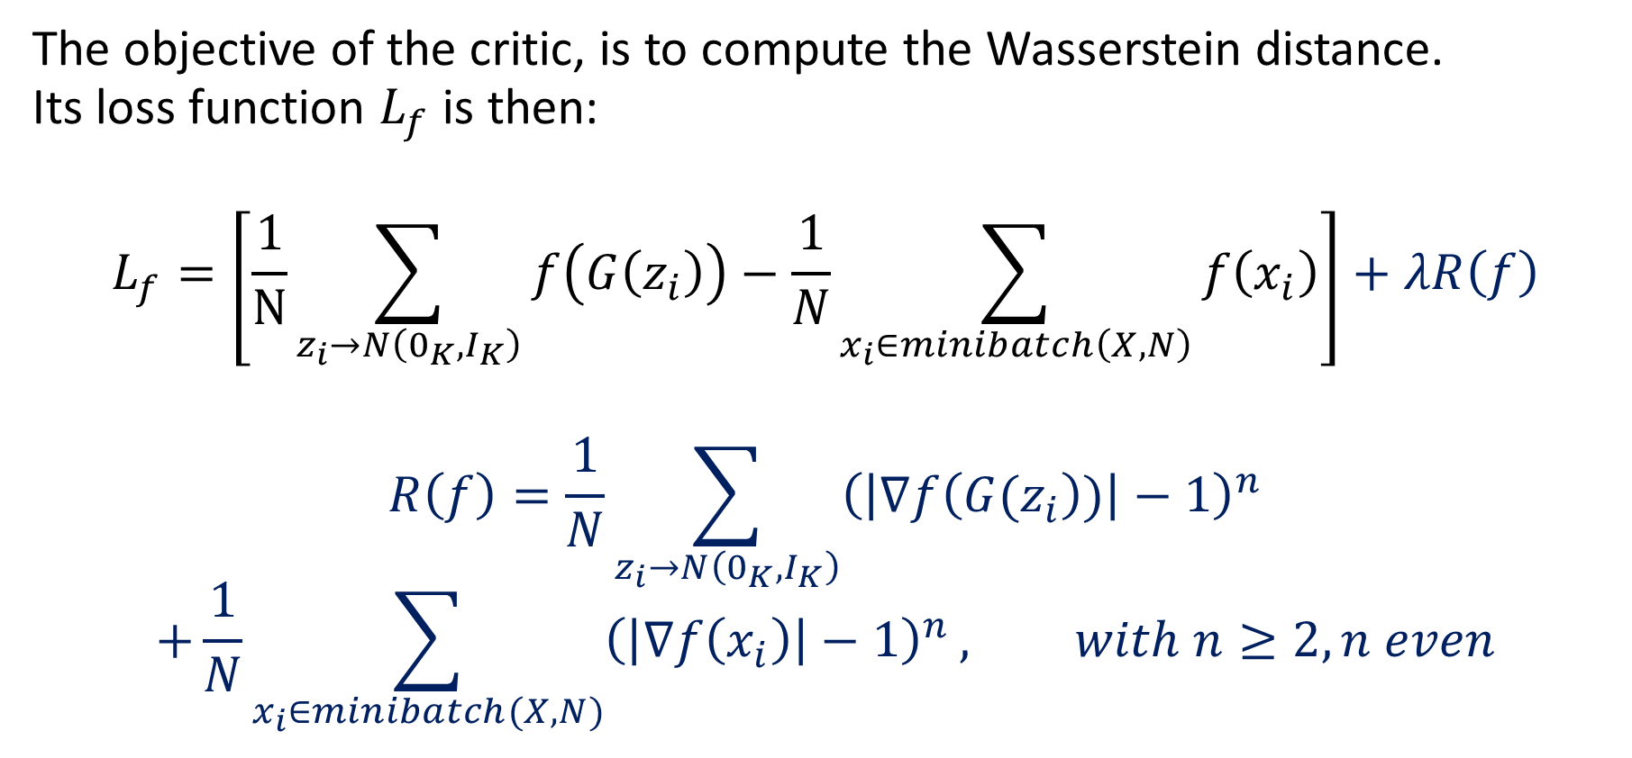
Wasserstein GAN idea
The objective of the critic, is to compute the Wasserstein distance. Its loss function $L_{f}$ is then:
$$L_{f}=\left[\frac{1}{N}\sum_{z_{i}→N\left(0_{K},I_{K}\right)}{f\left(G\left(z_{i}\right)\right)}−\frac{1}{N}\sum_{x_{i}∈minibatch\left(X,N\right)}{f\left(x_{i}\right)}\right]+λR\left(f\right)$$
$$R\left(f\right)=\frac{1}{N}\sum_{z_{i}→N\left(0_{K},I_{K}\right)}{{\left(\left|∇f\left({G(z}_{i}\right))\right|−1\right)}^{n}}$$
$$+\frac{1}{N}\sum_{x_{i}∈minibatch(X,N)}{{\left(\left|∇f\left(x_{i}\right)\right|−1\right)}^{n}}, with n≥2, n even$$

Slide 56
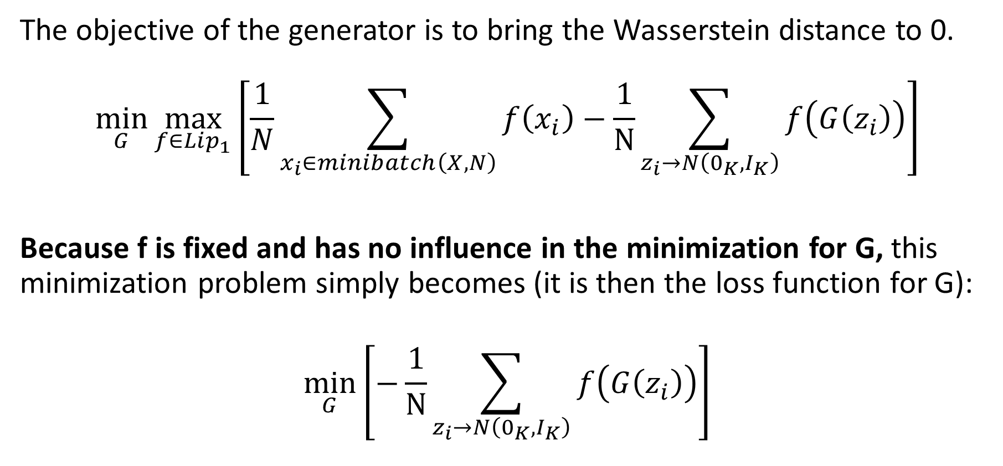
Wasserstein GAN idea
The objective of the generator is to bring the Wasserstein distance to 0.
$$\min_{G}{\max_{f∈Lip_{1}}\left[\frac{1}{N}\sum_{x_{i}∈minibatch\left(X,N\right)}{f\left(x_{i}\right)}−\frac{1}{N}\sum_{z_{i}→N\left(0_{K},I_{K}\right)}{f\left(G\left(z_{i}\right)\right)}\right]}$$
Because f is fixed and has no influence in the minimization for G, this minimization problem simply becomes (it is then the loss function for G):
$$\min_{G}\left[−\frac{1}{N}\sum_{z_{i}→N\left(0_{K},I_{K}\right)}{f\left(G\left(z_{i}\right)\right)}\right]$$

Slide 57
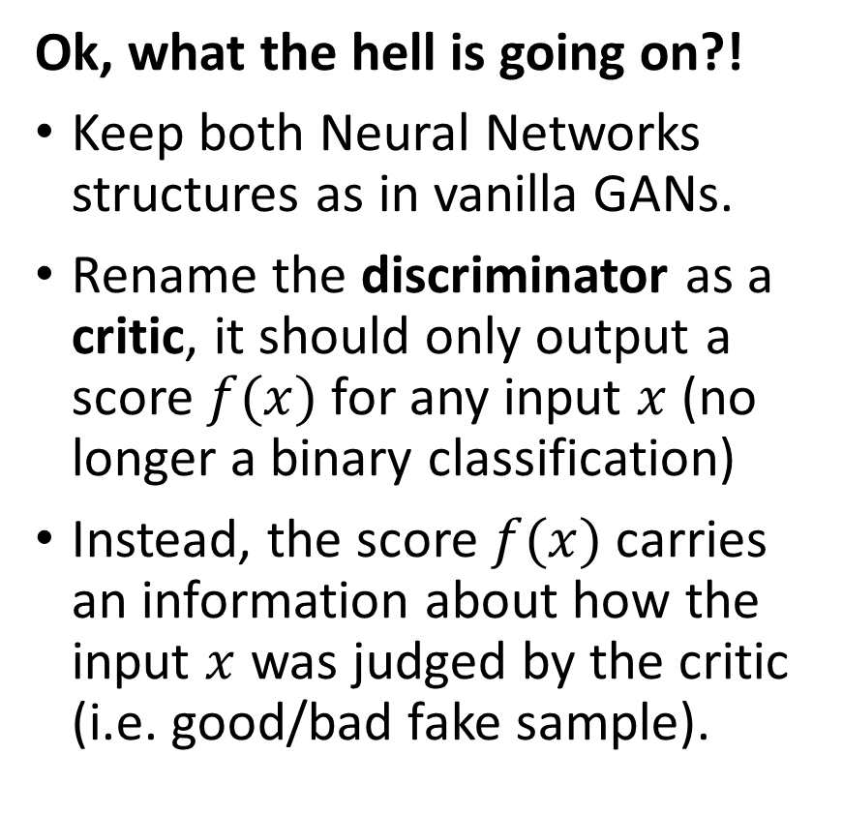
Wasserstein GAN idea
Ok, what the hell is going on?!
Keep both Neural Networks structures as in vanilla GANs.
Rename the discriminator as a critic, it should only output a score $f(x)$ for any input $x$ (no longer a binary classification)
Instead, the score $f(x)$ carries an information about how the input $x$ was judged by the critic (i.e. good/bad fake sample).
Real samples
Critic f
Generator G
Noise samples

Slide 58
Wasserstein GAN idea
This information is more useful in training the generator, as it provides a soft feedback, as opposed to a 0/1 score before.
This helps to train a good generator!
Bonus: all the loss functions are easy to compute, as they are simply mean values of the critic decisions over real/fake samples!
Real samples
Critic f
Generator G
Noise samples

Slide 59
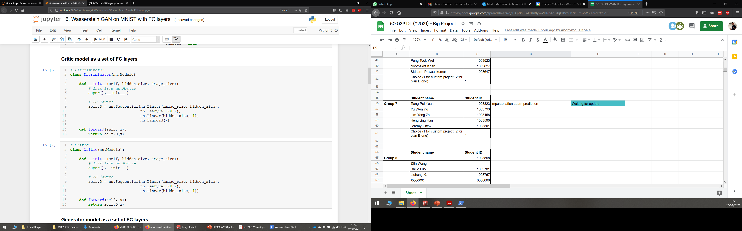

Wasserstein GAN implementation
Datasets and dataloaders do not change.
Networks do not change; we simply rename the discriminator by convention and remove its final sigmoid layer.

Slide 60

Wasserstein GAN implementation
Start by processing the samples
Generate N (mini-batch size) random noise samples, which will later be fed to generator.
Draw N (mini-batch size) samples from the dataset X, which will be fed to critic later on.
Flatten images (FC layers!)

Slide 61
Wasserstein GAN implementation
Train the critic (almost like before)
Pass real samples to f, get critic scores.
Compute the first half of the loss for f on these real samples.
Pass noise samples to generator G, and its outputs to critic f, get critic scores.
Compute the second half of the loss for f on these fake samples.
Calculate gradient penalty and add to loss
Backpropagate f on the computed loss.

Slide 62

Wasserstein GAN implementation

Slide 63
Wasserstein GAN implementation
Train the generator (almost like before)
Produce a fresh batch of noise samples to be fed to the generator.
Produce fake images by feeding these noise samples to generator G.
Pass fake images to critic f, get critic scores for these samples.
Backpropagate G on the computed loss.

Slide 64

Wasserstein GAN implementation

Slide 65

Wasserstein GAN implementation
Update loss history after each mini-batch.
Display on periodic epoch values for convenience.

Slide 66

WGAN training visuals
After training, we can visualize the losses.
Convergence seems to be happening on the losses.
(A few more iterations would have probably been good?).

Slide 67

WGAN training visuals

Slide 68

WGAN training visuals
Let us check if our generator G has been trained well enough to generate plausible (!) images!
Overall, plausible and better looking images!
As before, could remove noise and improve the quality of images, with TransposeConv2d instead of FC!

Slide 69

Limits of vanilla/Wasserstein GANs
Issue #1: GANs are effective at generating images, but
they are limited to small images sizes,
because of model stability,
and training required.

Slide 70
Limits of vanilla/Wasserstein GANs
Issue #1: GANs are effective at generating images, but
they are limited to small images sizes,
because of model stability,
and training required.
Generating high-resolution images is challenging for GANs, because the generator must learn how to produce both large structure and fine details at the same time.

Slide 71

Limits of vanilla/Wasserstein GANs
Issue #2: Lack of control on the generators outputs
Limited understanding of the impact of noise vectors used as input in generators (amount of randomness? structure of the latent space?)

Slide 72

Limits of vanilla/Wasserstein GANs
Issue #2: Lack of control on the generators outputs
Limited understanding of the impact of noise vectors used as input in generators (amount of randomness? structure of the latent space?)
How to disentangle features/properties in images and add controls for these properties to the generator model?

Slide 73
In this lecture
In this lecture
Limits of Vanilla/Wasserstein GANs
Issue#1 → Progressive GANs
key ideas, procedure, practical implementation
Issue #2 → Conditional and Style GANs
key ideas, procedure, practical implementation

Slide 74

Progressive GANs: core idea
Issue #1: Generating high-resolution images is challenging for GANs, because the generator must learn how to produce both large structure and fine details at the same time.
Core idea: Novel GAN approach to generate large high-quality images, by incrementally increasing the sizes of the models during training.
[PGGAN] Karras, T., Aila, T., Laine, S., & Lehtinen, J. (2017). Progressive growing of gans for improved quality, stability, and variation.

Slide 75

Note: CNN layers were progressively learning to recognize finer and finer details.
Starting from early layers detecting basic patterns like edges, corners, colors…
To deeper layers recognizing more advanced patterns (eyes, noses, mouths, etc.)…
And the training progress was gradual: early layers would train on the first iterations, and progressively the training would “propagate” to deeper layers

Slide 76
G1 – 4x4 images (coarse details)
Starting point
G2 reuses G1 to produce 8x8 images, with more and finer details
Transfer learning on G1
G3 reuses G2 to produce 16x16 images, with more and finer details
Transfer learning on G2
GN reuses G(N-1) to produce 1024x1024 images, with more and finer details
Transfer learning on G(N-1)
…
Keep on increasing in a progressive way
Core idea being the progressive GANs approach:
We will basically attempt to reproduce the same thing, by training successive “mutations”/”versions” of the generator, with increasing output sizes on images.
Reusing the previous “mutations”/”versions” of the generator for the next one.

Slide 77
Progressive GANs: core idea
Progressive (growing) GANs [PGGAN]:
Progressive Growing GAN involves using a generator and discriminator model with the same general structure and starting with very small images.
During training, new blocks of convolutional layers are systematically added to both the generator model and the discriminator models.
[PGGAN] Karras, T., Aila, T., Laine, S., & Lehtinen, J. (2017). Progressive growing of gans for improved quality, stability, and variation.

Slide 78


Progressive GANs: implementation details (G)
Idea: add blocks of layers and perform phasing in the addition of the blocks.
Phasing: use a skip connection to connect the new block to the output of the generator and add it to the existing output layer with a weighting.
Weighting: contribution of the upsampled 16×16 layer is weighted by $(1 –α)$, and the contribution of the new 32×32 layer is weighted by $α$.

Slide 79

Progressive GANs: implementation details (G)
Idea: add blocks of layers and perform phasing in the addition of the blocks.
Phasing: use a skip connection to connect the new block to the output of the generator and add it to the existing output layer with a weighting.
Weighting: contribution of the upsampled 16×16 layer is weighted by $(1 –α)$, and the contribution of the new 32×32 layer is weighted by $α$.

Slide 80

Progressive GANs: implementation details (G)
Idea: add blocks of layers and perform phasing in the addition of the blocks.
Phasing: use a skip connection to connect the new block to the output of the generator and add it to the existing output layer with a weighting.
Weighting: contribution of the upsampled 16×16 layer is weighted by $(1 –α)$, and the contribution of the new 32×32 layer is weighted by $α$.

Slide 81

Progressive GANs: implementation details (G)
Idea: add blocks of layers and perform phasing in the addition of the blocks.
Phasing: use a skip connection to connect the new block to the output of the generator and add it to the existing output layer with a weighting.
Weighting: contribution of the upsampled 16×16 layer is weighted by $(1 –α)$, and the contribution of the new 32×32 layer is weighted by $α$.
Resolution increment: double resolution at each step.
Values of $α$: progressively increase from 0 to 1.
All layers remain trainable.

Slide 82
Progressive GANs: implementation details (D)
Idea: same as G, but the other way around. Adding a new block of convolutional layers for the input of D to support larger images.
Phasing: use a skip connection to connect the new block to the input of the discriminator and add it to the existing input layer with a weighting.
The input image is downsampled to 16×16 using average pooling so that it can pass through the existing 16×16 convolutional layers.

Slide 83
Progressive GANs: implementation details (D)
Idea: same as G, but the other way around. Adding a new block of convolutional layers for the input of D to support larger images.
Phasing: use a skip connection to connect the new block to the input of the discriminator and add it to the existing input layer with a weighting.
The input image is downsampled to 16×16 using average pooling so that it can pass through the existing 16×16 convolutional layers.

Slide 84
Progressive GANs: implementation details (D)
Idea: same as G, but the other way around. Adding a new block of convolutional layers for the input of D to support larger images.
Phasing: use a skip connection to connect the new block to the input of the discriminator and add it to the existing input layer with a weighting.
The input image is downsampled to 16×16 using average pooling so that it can pass through the existing 16×16 convolutional layers.

Slide 85
Progressive GANs: implementation details (D)
Idea: same as G, but the other way around. Adding a new block of convolutional layers for the input of D to support larger images.
Phasing: use a skip connection to connect the new block to the input of the discriminator and add it to the existing input layer with a weighting.
The input image is downsampled to 16×16 using average pooling so that it can pass through the existing 16×16 convolutional layers.
The output of the new 32×32 block of layers is also downsampled using average pooling so that it can be used as input to the existing 16×16 block.

Slide 86

Progressive GANs: implementation details (D)
Idea: same as G, but the other way around. Adding a new block of convolutional layers for the input of D to support larger images.
Phasing: use a skip connection to connect the new block to the input of the discriminator and add it to the existing input layer with a weighting.
The input image is downsampled to 16×16 using average pooling so that it can pass through the existing 16×16 convolutional layers.
The output of the new 32×32 block of layers is also downsampled using average pooling so that it can be used as input to the existing 16×16 block.
Double resolution size at each step, $α$ progressively increases from 0 to 1. All layers remain trainable.

Slide 87
Progressive GANs: result comparison
Progressive (growing) GANs [PGGAN]:
Result: capable of generating photorealistic synthetic faces and objects at high resolution that are remarkably realistic.
Figure: DCGAN 32x32 generated pictures
[PGGAN] Karras, T., Aila, T., Laine, S., & Lehtinen, J. (2017). Progressive growing of gans for improved quality, stability, and variation.

Slide 88
Progressive GANs: result comparison
Progressive (growing) GANs [PGGAN]:
Result: capable of generating photorealistic synthetic faces and objects at high resolution that are remarkably realistic.
Original celebrity DCGAN model: outputs 32x32 images, flaws in details.
Figure: DCGAN 32x32 generated pictures
[PGGAN] Karras, T., Aila, T., Laine, S., & Lehtinen, J. (2017). Progressive growing of gans for improved quality, stability, and variation.

Slide 89
Progressive GANs: result comparison
Progressive (growing) GANs [PGGAN]:
Result: capable of generating photorealistic synthetic faces and objects at high resolution that are remarkably realistic.
Original celebrity DCGAN model: outputs 32x32 images, flaws in details.
Progressive celebrity HQ GANs: outputs 1024x1024 images…
Figure: DCGAN 32x32 generated pictures
[PGGAN] Karras, T., Aila, T., Laine, S., & Lehtinen, J. (2017). Progressive growing of gans for improved quality, stability, and variation.

Slide 90



And they are quite realistic (!)
Progressive (growing) GANs [PGGAN]:
Result: capable of generating photorealistic synthetic faces and objects at high resolution that are remarkably realistic.
Original celebrity DCGAN model: outputs 32x32 images, flaws in details.
Progressive celebrityHQ GANs: outputs 1024x1024 images. And…
Figure: DCGAN 32x32 generated pictures
[PGGAN] Karras, T., Aila, T., Laine, S., & Lehtinen, J. (2017). Progressive growing of gans for improved quality, stability, and variation.

Slide 91
Progressive GANs: useful links
[PGGAN] Karras, T., Aila, T., Laine, S., & Lehtinen, J. (2017). Progressive growing of gans for improved quality, stability, and variation.
Paper [PGGAN]: https://arxiv.org/pdf/1710.10196.pdf
Demo code and pre-trained models: https://pytorch.org/hub/facebookresearch_pytorch-gan-zoo_pgan/ https://github.com/facebookresearch/pytorch_GAN_zoo
Learn more (Nvidia/Youtube video with PGGANs paper results): https://www.youtube.com/watch?time_continue=4&v=G06dEcZ-QTg&feature=emb_logo

Slide 92

Progressive GANs: a note on training time
Source: [PGGAN] Karras, T., Aila, T., Laine, S., & Lehtinen, J. (2017). Progressive growing of gans for improved quality, stability, and variation.

Slide 93
Conditional GANs
Issue #2: Lack of control on the generators outputs.
Core idea of Conditional GANs [CondGAN]: Add some deterministic values to the noise samples used in the generator.
This deterministic value corresponds to the class you expect the sample to have (e.g. generate a handwritten 7).
Generator task is to fool the discriminator/critic by generating a sample, which will be classified as a “real 7” and not anything else (“fake 7”, “real 6” are both considered failure cases).

Slide 94

Conditional GANs
Core idea of Conditional GANs [CondGAN]: Add some deterministic values to the noise samples used in the generator.
This deterministic value corresponds to the class you expect the sample to have (e.g. generate a handwritten 7).
Generator task is to fool the discriminator/critic by generating a sample, which will be classified as a “real 7” and not anything else (“fake 7”, “real 6” are both considered failure cases).

Slide 95

CycleGAN
Core idea of CycleGANs [CycleGAN]: do not use noise as input for generator, use another image that you wish to transform!
Train an autoencoder style of architecture, with two generators.
One generator $G_{1}$ that transforms images of zebras into horses, and one generator $G_{2}$that transforms images of horses into zebras.
Train both generators to accomplish $G_{1}$($G_{2}$(x)) = x.
By doing so, you get a generator, which transforms images of a certain type into images of another type!

Slide 96

GANs and ethics
https://www.youtube.com/watch?v=bE1KWpoX9Hk

Slide 97

GANs and ethics
https://www.youtube.com/watch?v=bE1KWpoX9Hk
https://www.bbc.com/news/technology-48799045

Slide 98


GANs and ethics
https://www.technologyreview.com/2018/02/21/145289/the-ganfather-the-man-whos-given-machines-the-gift-of-imagination/

Slide 99
GANs and ethics
https://www.technologyreview.com/2018/02/21/145289/the-ganfather-the-man-whos-given-machines-the-gift-of-imagination/

Slide 100

What about diffusion models?!
You might have heard diffusion models…
E.g. Dall-E2, StableDiffusion, MidJourney, etc.
Turns out: special type of generative models, to be discussed on a special lecture during Week 12 or 13!

Slide 101
Conclusion
In this lecture
More advanced concepts on GANs
Wasserstein distance in the GAN loss function
Progressive GANs
Style GANs
Conditional GANs and CycleGANs
Deepfakes and ethics

Slide 102
Learn more about these topics
Out of class, for those of you who are curious
[AutoEnc] Hinton and Salakhutdinov, “Reducing the Dimensionality of Data with Neural Networks”, 2006. https://paperswithcode.com/paper/reducing-the-dimensionality-of-data-with
[VarAutoEnc] Kingma and Welling, “Auto-Encoding Variational Bayes”, 2014. https://arxiv.org/abs/1312.6114
[GAN] Goodfellow et al., “Generative Adversarial Networks”, 2014. https://arxiv.org/abs/1406.2661

Slide 103
Learn more about these topics
Out of class, for those of you who are curious
[WGAN] Arjowski et al., ”Towards Principled Methods for Training Generative Adversarial Networks”, 2017. https://arxiv.org/abs/1701.04862
[PGGAN] Karras, et al., “Progressive growing of gans for improved quality, stability, and variation”, 2017. https://arxiv.org/pdf/1710.10196.pdf
[StyleGAN] Karras, T., Laine, S., & Aila, T. (2019). A style-based generator architecture for generative adversarial networks. https://arxiv.org/pdf/1812.04948.pdf

Slide 104
Learn more about these topics
Out of class, for those of you who are curious
[Villani2008] Villani, “Optimal transport, old and new”, 2008. https://cedricvillani.org/sites/dev/files/old_images/2012/08/preprint-1.pdf
[CondGAN] Mirza et al. “Conditional Generative Adversarial Nets”, 2014. https://arxiv.org/abs/1411.1784
[CycleGAN] Zhu et al., “Unpaired Image-to-Image Translation using Cycle-Consistent Adversarial Networks”, 2017. https://arxiv.org/abs/1703.10593

Slide 105
Learn more about these topics
Tracking important names (Track their works and follow them on Scholar, Twitter, or whatever works for you!)
Tero Karras: Researcher at NVIDIA. https://scholar.google.fi/citations?user=-50qJW8AAAAJ&hl=en
Mehdi Mirza: Researcher at DeepMind. Co-inventor of GANs with Goodfellow. https://scholar.google.com/citations?user=c646VbAAAAAJ&hl=fr

Slide 106
Learn more about these topics
Out of class, for those of you who are curious
Jordan Peele impersonates Obama using GANs https://www.youtube.com/watch?v=bE1KWpoX9Hk
Shutting down an AI that could remove clothes from people https://www.bbc.com/news/technology-48799045
The man who’s given machines the gift of imagination https://www.technologyreview.com/2018/02/21/145289/the-ganfather-the-man-whos-given-machines-the-gift-of-imagination/
Create fake landscape pictures, post these on Instagram, pretend these were taken in Singapore and let people wonder where it is. http://nvidia-research-mingyuliu.com/gaugan/

Slide 107

Style GANs: core idea
Issue #2: Lack of control on the generators outputs.
Style GANs [StyleGAN]: PGGAN++
Core idea: Reuse PGGAN, but change the architecture of generator to introduce control over the style of generated images at different levels of detail, from high-level features such as background and foreground, to fine-grained details of objects or subjects.
[StyleGAN] Karras, T., Laine, S., & Aila, T. (2019). A style-based generator architecture for generative adversarial networks.

Slide 108
Style GAN: implementation details
Reuse PGGAN: Incremental growing of the models, but also change the architecture of the generator significantly.

Slide 109
Style GAN: implementation details
Reuse PGGAN: Incremental growing of the models, but also change the architecture of the generator significantly.
Input change: no longer take a noise vector as input.
instead, there are two new sources of randomness used to generate a synthetic image,
a standalone mapping network
and noise introduced at each layer of the generator.

Slide 110
Style GAN: implementation details
Reuse PGGAN: Incremental growing of the models, but also change the architecture of the generator significantly.
Input change: no longer take a noise vector as input.
instead, there are two new sources of randomness used to generate a synthetic image,
a standalone mapping network
and noise introduced at each layer of the generator.
Mapping network: output from the mapping network is a vector defining the styles, later integrated at each point in the generator model. This style vector gives control over the style of the generated image.

Slide 111
Style GAN: implementation details
Reuse PGGAN: Incremental growing of the models, but also change the architecture of the generator significantly.
Input change: no longer take a noise vector as input.
instead, there are two new sources of randomness used to generate a synthetic image,
a standalone mapping network
and noise introduced at each layer of the generator.
Mapping network: output from the mapping network is a vector defining the styles, later integrated at each point in the generator model. This style vector gives control over the style of the generated image.
Noise introduction: per-block incorporation of style vector and noise allows each block to localize both the interpretation of style and induce random variation to a given level of detail.

Slide 112


Style GAN: implementation details
1. Mapping network: a standalone mapping network.
consisting of simple Dense layers NN,
takes a noise vector $z$ as input
and generates a style vector $w$.

Slide 113

Style GAN: implementation details
2. AdaIN: style vector is incorporated into each block of the generator model after the conv. layers, via adaptive instance normalization (AdaIN).
standardize the output of feature map to a standard Gaussian,
in a very similar way as batchnorm.

Slide 114

Style GAN: implementation details
2. AdaIN: breaking down the layer
Given a content input $x$, with $i∈[1,N]$ channels, and a style input $y$,
AdaIN aligns the channel-wise mean and variance of $x$, to match those of $y$.
AdaIN has no learnable affine parameters, it adaptively computes the affine parameters from the style input.

Slide 115

Style GAN: implementation details
2. AdaIN: breaking down the layer
As in BatchNorm, we simply scale the normalized content input $x$ with $σ(y)$, and shift it with $μ(y)$.
These statistics are computed across all spatial locations.
AdaIN transfers feature statistics, specifically the channel-wise mean and variance (= style transfer).

Slide 116

Style GAN: implementation details
2. AdaIN: breaking down the layer
As in BatchNorm, we simply scale the normalized content input $x$ with $σ(y)$, and shift it with $μ(y)$.
These statistics are computed across all spatial locations.
AdaIN transfers feature statistics, specifically the channel-wise mean and variance (= style transfer).

Slide 117

Style GAN: implementation details
3. Local noise addition: Gaussian noise is added to each of the conv. prior to the AdaIN operations.
More specifically, single-channel images $B$ consisting of uncorrelated Gaussian noise.
Feed a dedicated noise image to each layer, broadcasted to all feature maps using learned per-feature scaling factors and added to the output of each convolution
This noise introduces style-level variation at a given level of detail.

Slide 118
Style GAN: results
The StyleGAN is both effective at generating large high-quality images and at controlling the style of the generated images.
Can later extract the style vectors of an image, and synthesize an image combining both style features.

Slide 119
Style GANs: useful links
[StyleGAN] Karras, T., Laine, S., & Aila, T. (2019). A style-based generator architecture for generative adversarial networks.
Paper [StyleGAN]: https://arxiv.org/pdf/1812.04948.pdf
Demo code and pre-trained models (same repo as PGGAN): https://github.com/facebookresearch/pytorch_GAN_zoo
Learn more (Nvidia/Youtube video with PGGANs paper results): https://www.youtube.com/watch?v=kSLJriaOumA&feature=emb_title

